Slide 1
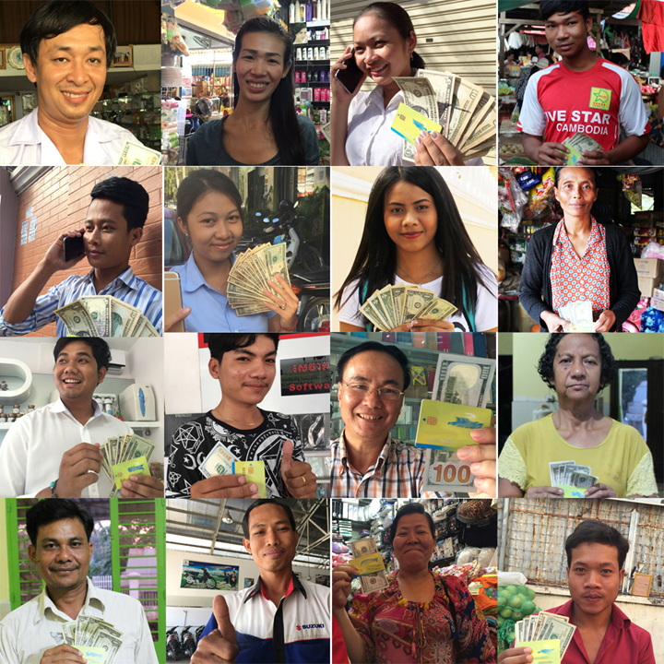

Payday loans
លុយមុនបើកប្រាក់ខែ
in Cambodia !

Slide 2
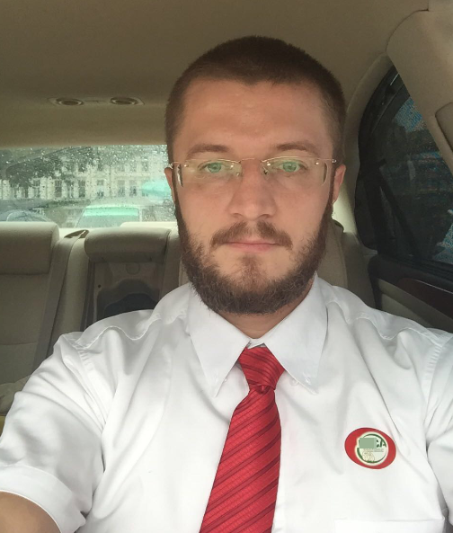
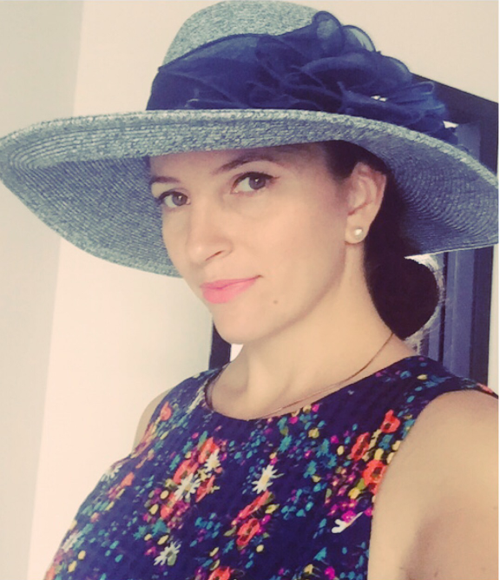
Anna
We set up
PayDay loan in Cambodia
Anton
Notes:
Здравствуйте, уважаемые Коллеги!
Меня зовут Анна,
а это Антон
Поверьте, очень сложно уместить в 15 минутную презентацию опыт открытия новой страны и год работы без выходных, работая по 15 часов в день ежедневно.
И у Вас обязательно появятся вопросы, на которые мы с радостью ответим сегодня или в любое другое время.
Российский рынок, по ряду причин, был нам малоинтересен. И нам, первооткрывателям в душе, всегда хочется двигаться вперед и открывать новые возможности.
Так и было решено поехать в Азию летом 2015года.

Slide 3

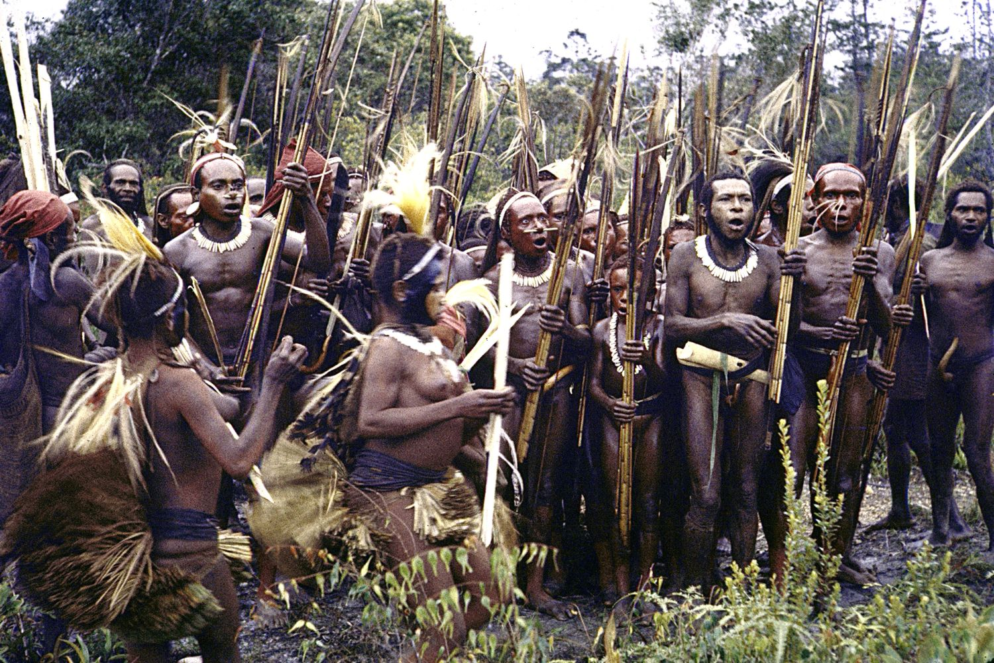
Asia is these MIDDLE AGES. There is EXTREMELY LOW manufacturability -which is compensated by the GIANT number of employees (the good thing is that they are cheap)
In Russia, MFO's business automation technologies are at a high level. Bringing them to Asia is actually the same as bringing the Kalashnikov assault rifle in the Middle Ages
Notes:
в 2015 году нам казалось что ​Российский рынок уже сильно зарегулирован, сильна конкуренция,
и я подумал - а почему бы не стать первооткрывателями PAyDay Loan в стране где этого еще не придумали?!
сказано - сделано. собрались и поехали в камбоджу!
наши приключения - начались!

Slide 4
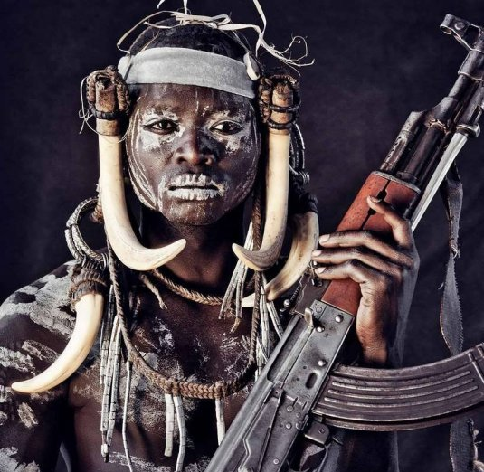
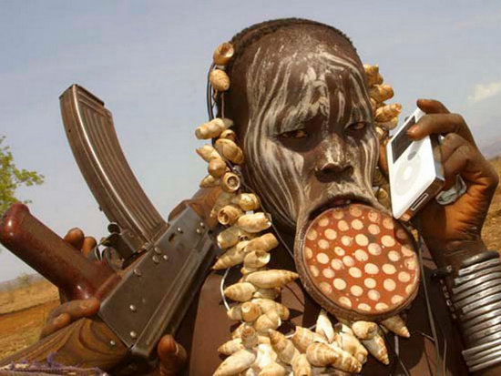
That is the way the ideal employee should look like:
local
cheap
convincing sales manager
eager beaver
Notes:
Здравствуйте, уважаемые Коллеги!
Меня зовут Анна,
а это Антон
Поверьте, очень сложно уместить в 15 минутную презентацию опыт открытия новой страны и год работы без выходных, работая по 15 часов в день ежедневно.
И у Вас обязательно появятся вопросы, на которые мы с радостью ответим сегодня или в любое другое время.
Российский рынок, по ряду причин, был нам малоинтересен. И нам, первооткрывателям в душе, всегда хочется двигаться вперед и открывать новые возможности.
Так и было решено поехать в Азию летом 2015года.

Slide 5
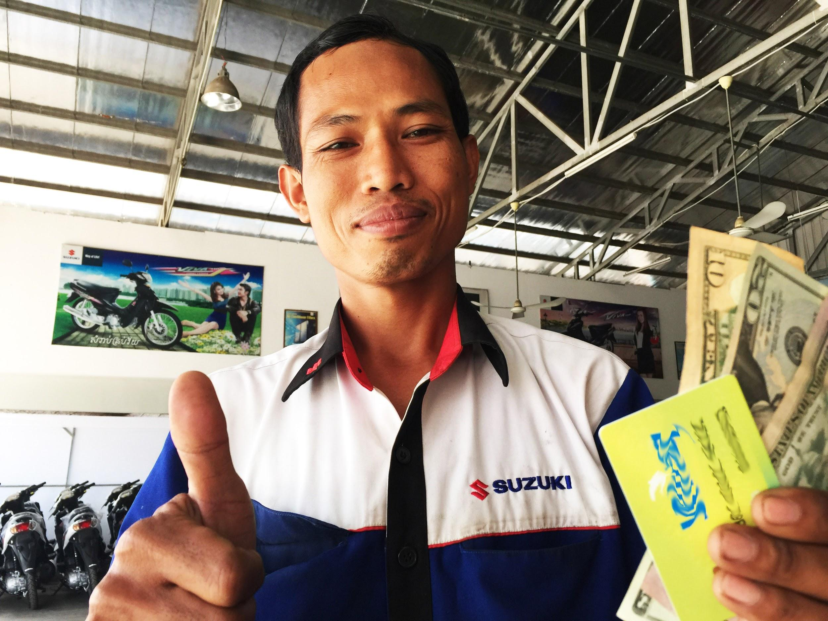
And this is our perfect client
Notes:
Здравствуйте, уважаемые Коллеги!
Меня зовут Анна,
а это Антон
Поверьте, очень сложно уместить в 15 минутную презентацию опыт открытия новой страны и год работы без выходных, работая по 15 часов в день ежедневно.
И у Вас обязательно появятся вопросы, на которые мы с радостью ответим сегодня или в любое другое время.
Российский рынок, по ряду причин, был нам малоинтересен. И нам, первооткрывателям в душе, всегда хочется двигаться вперед и открывать новые возможности.
Так и было решено поехать в Азию летом 2015года.

Slide 6
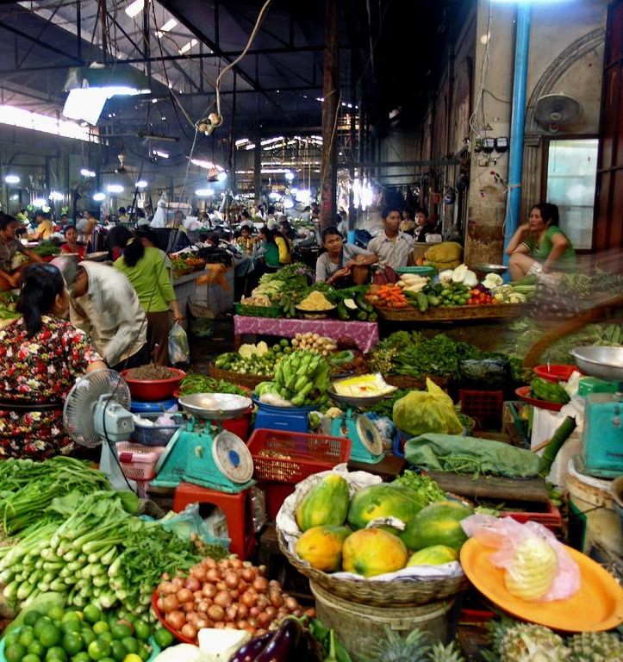
Market situation in Cambodia
01

Slide 7
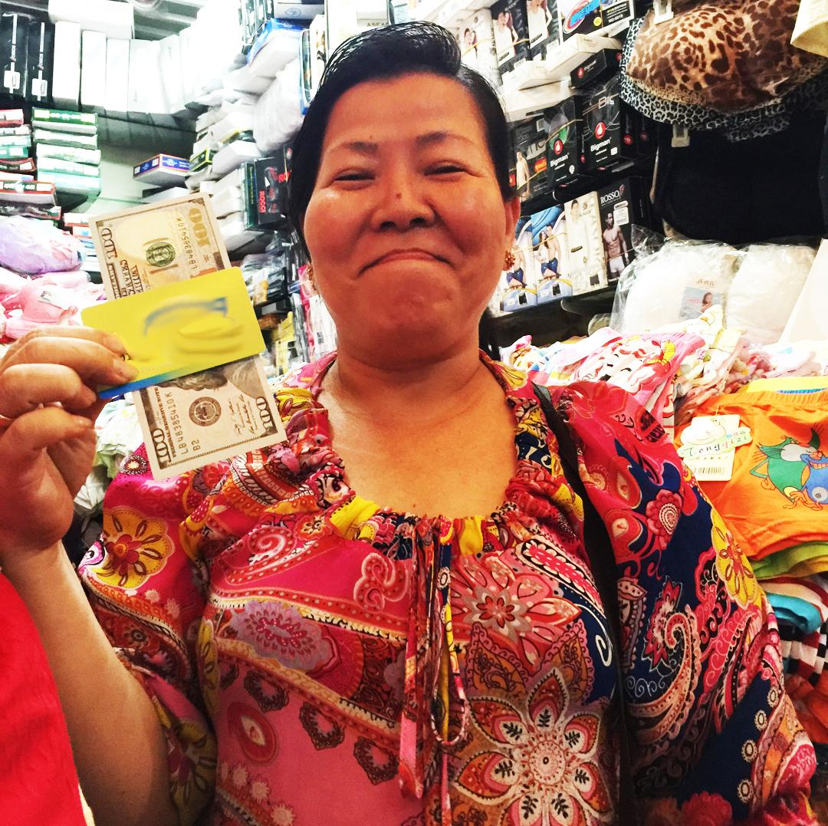
Local banks and MFO even the thought about non_collateral lending money is scary

Slide 8
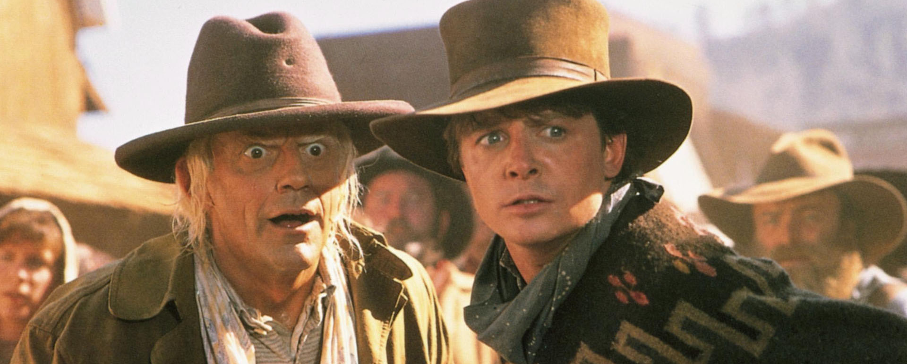
Non collateral loans
DO NOT EXSIST.

Slide 9
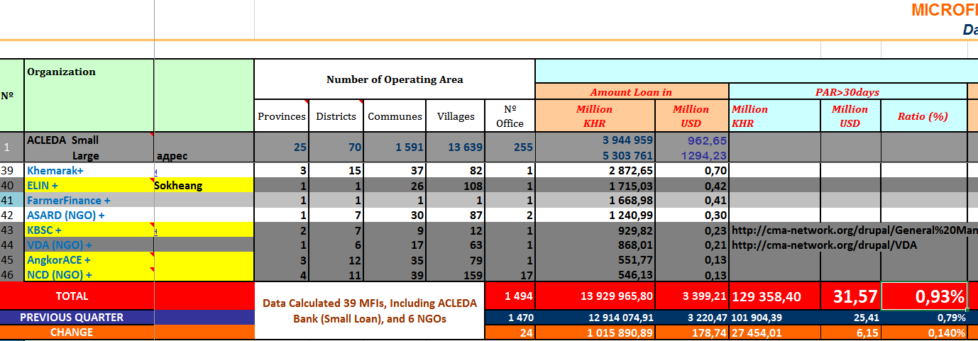
overdue in Cambodian MFOs for more than 30 days
totals 0,9% :)

Slide 10










About 50 MFIs are involved in consumer lending
Authorized capital - $ 1.5 million, which is similar to a small bank in Russia
Average check is up to $ 5000
Collateral can be provided by: land, houses, original passports and a bail granter represented by the local elder

Slide 11

What about Banks ?
they also earn money!

Slide 12
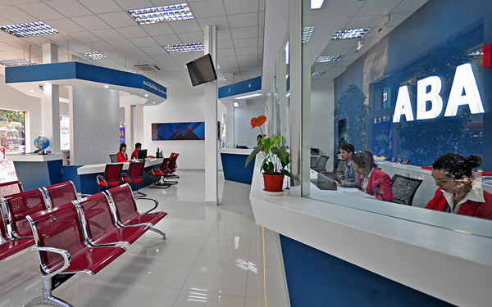
ABA-Bank: the top 3 Cambodian banks (at the level of Russian Alfa Bank) All Top Management speak Russian (!) - it's easy to negotiate :) according to the colleagues from ABA - all transactions
up to $ 500 000 are free from financial monitoring
and the Bank lets it pass, even if the money comes from Afghanistan or Syria. But, of course, with a sum that is over $ 500 000 a contract can be demanded.

Slide 13
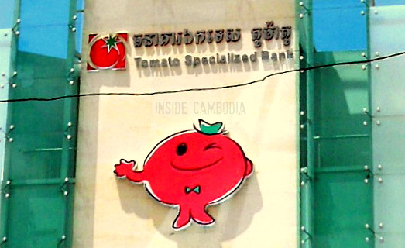
In Cambodia:
36 Banks for 1.5 million citizens
the country takes the honorable 7th place on money laundering :)
full trust to banks of locals
no precedents of banks burst
none of the banks have been revoked the license
no financial pyramids
and it is very convenient for business that the official currency in the country is the US dollar
Common representative: TOMATO bank
Perhaps, it lands money for growing of tomatos:)

Slide 14
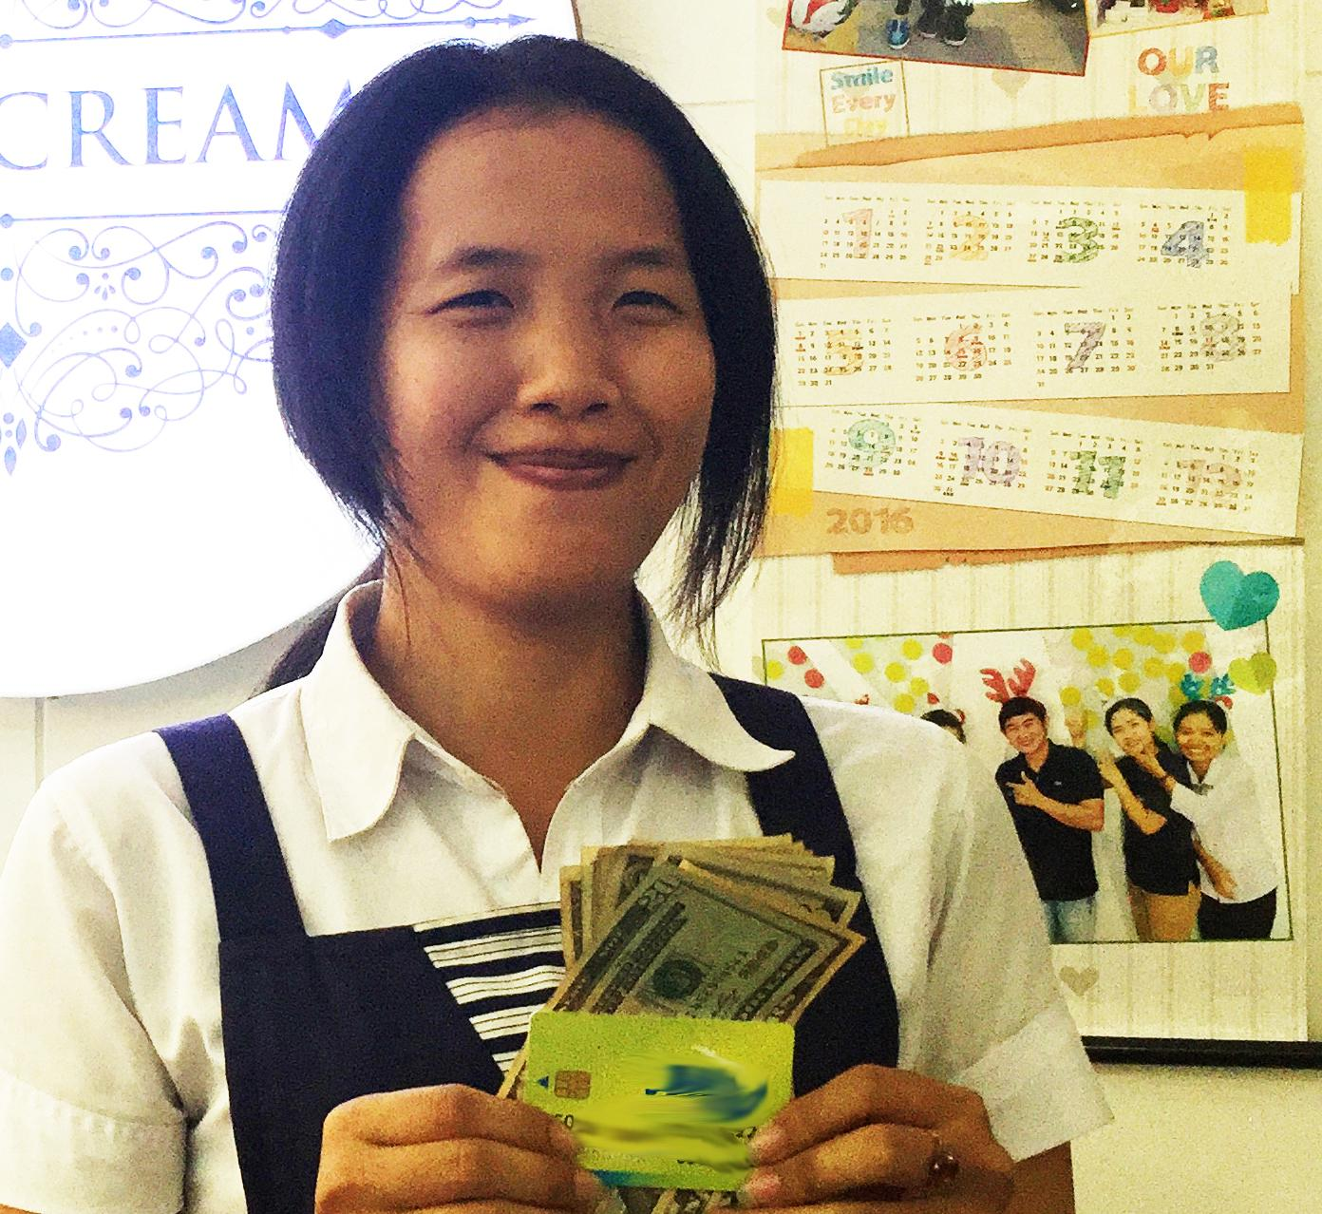
a very simple checklist: how to test the country for "discoverability"
02

Slide 15
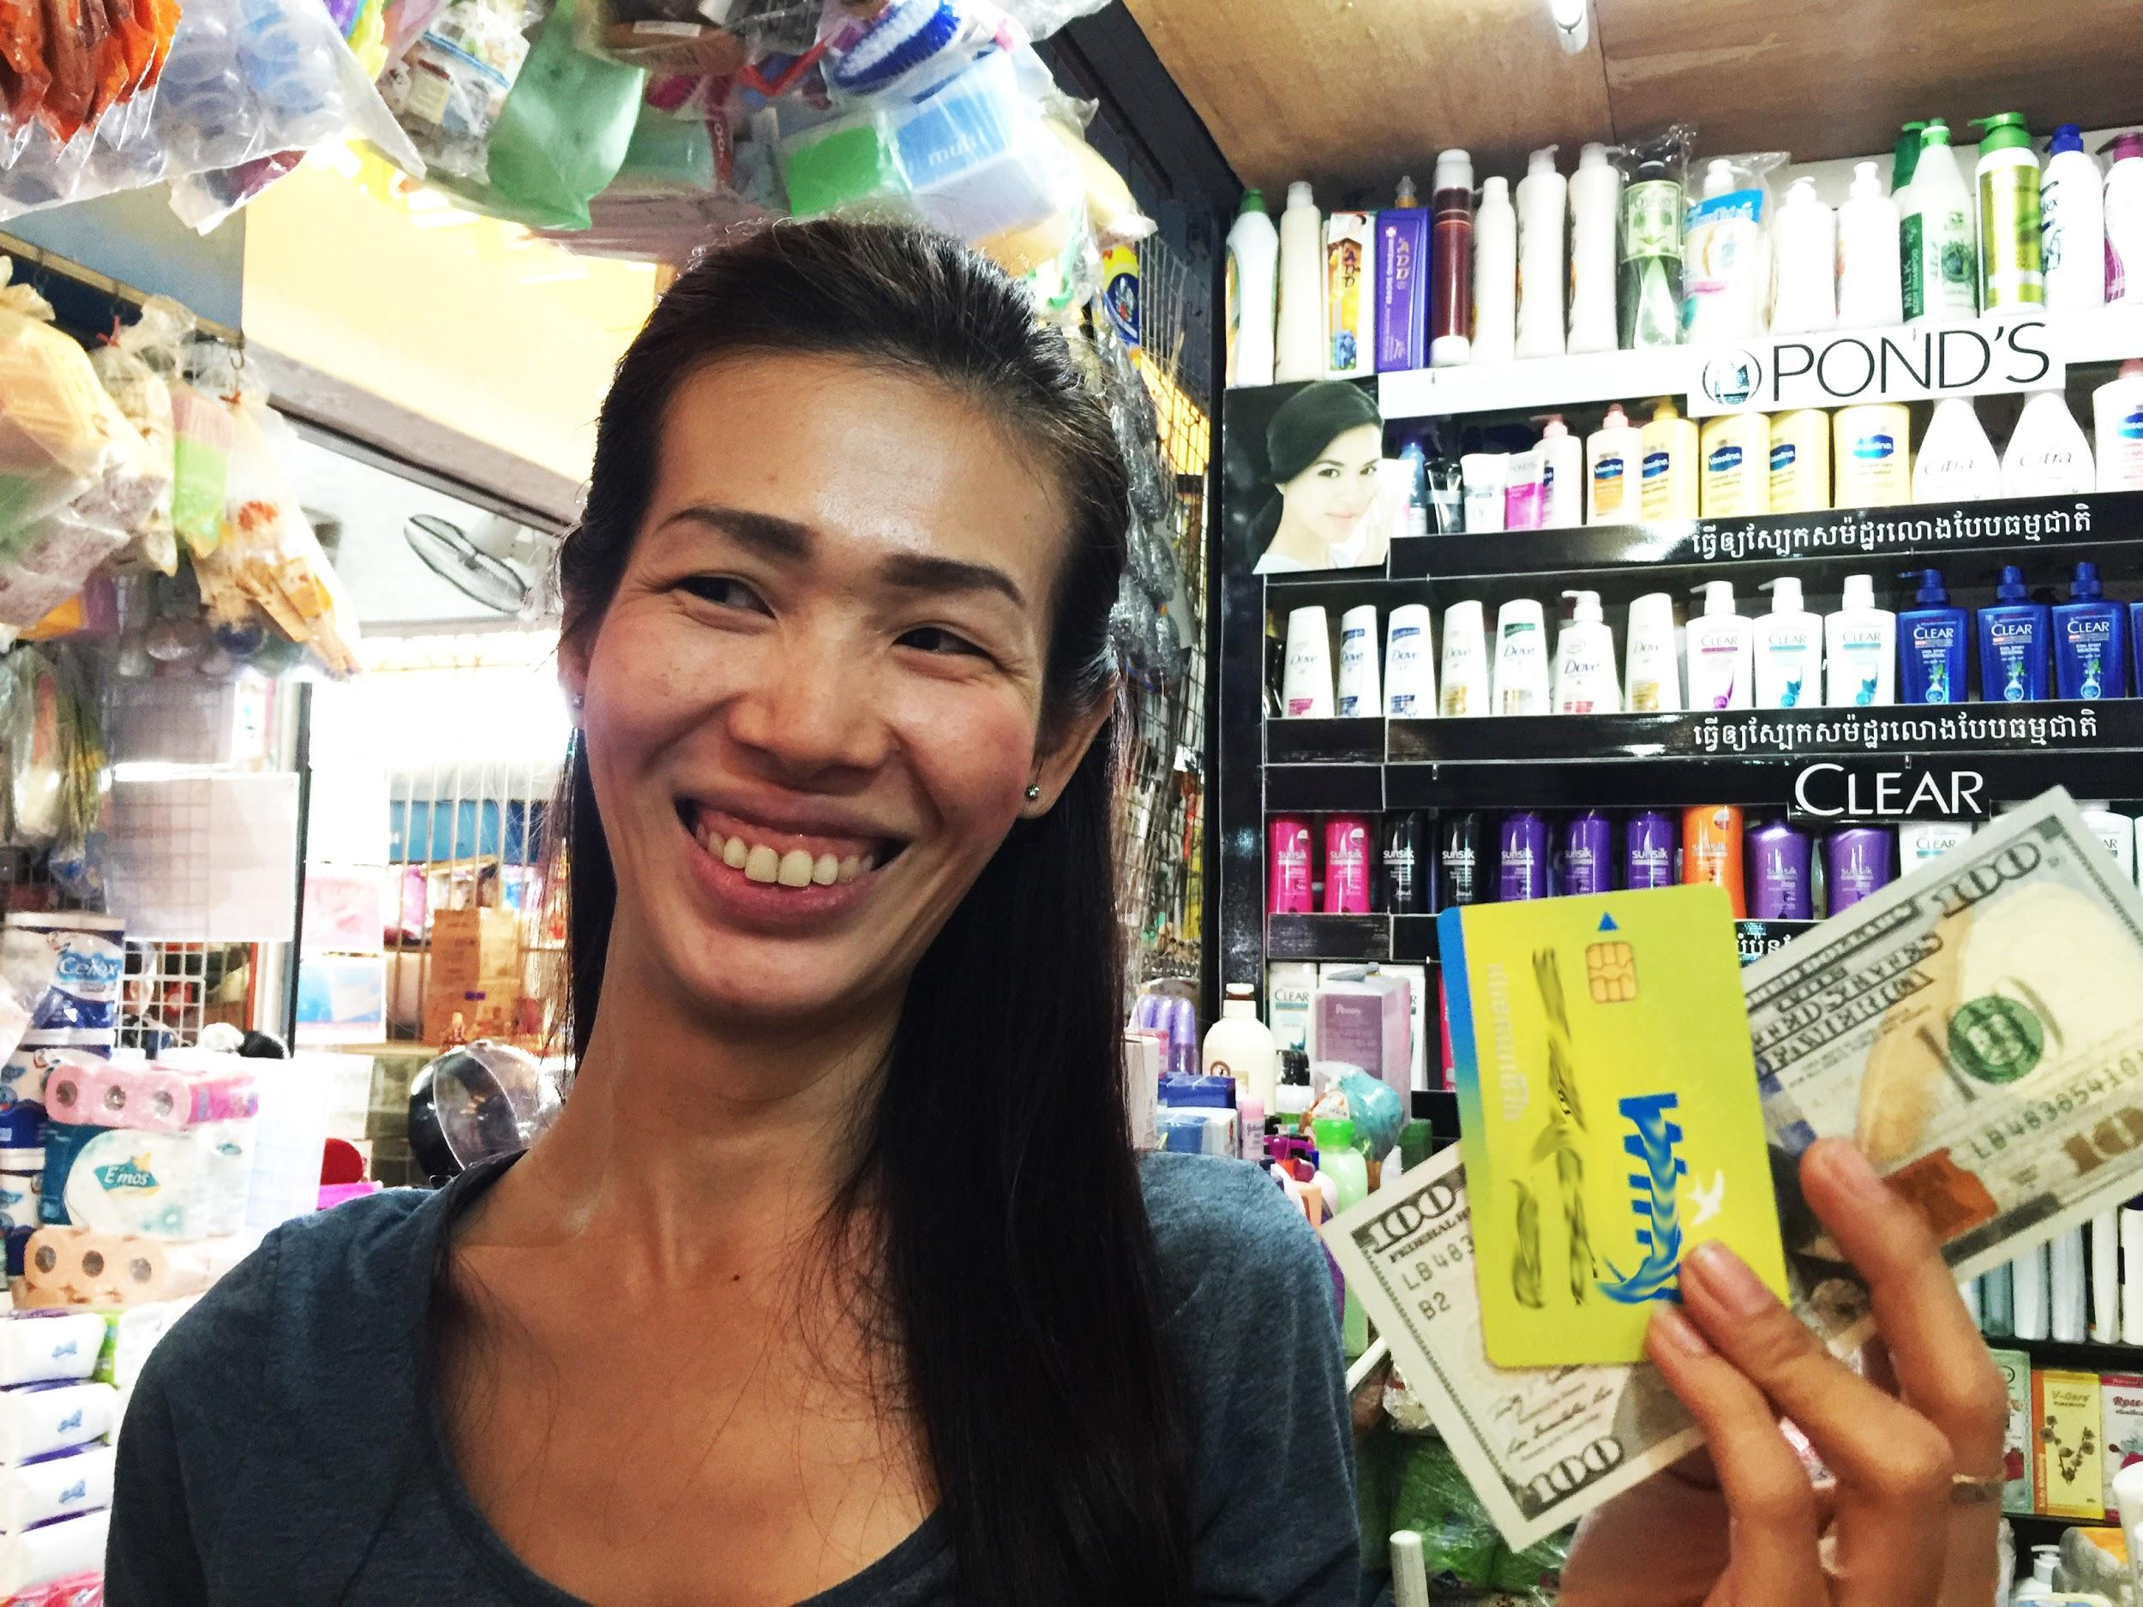

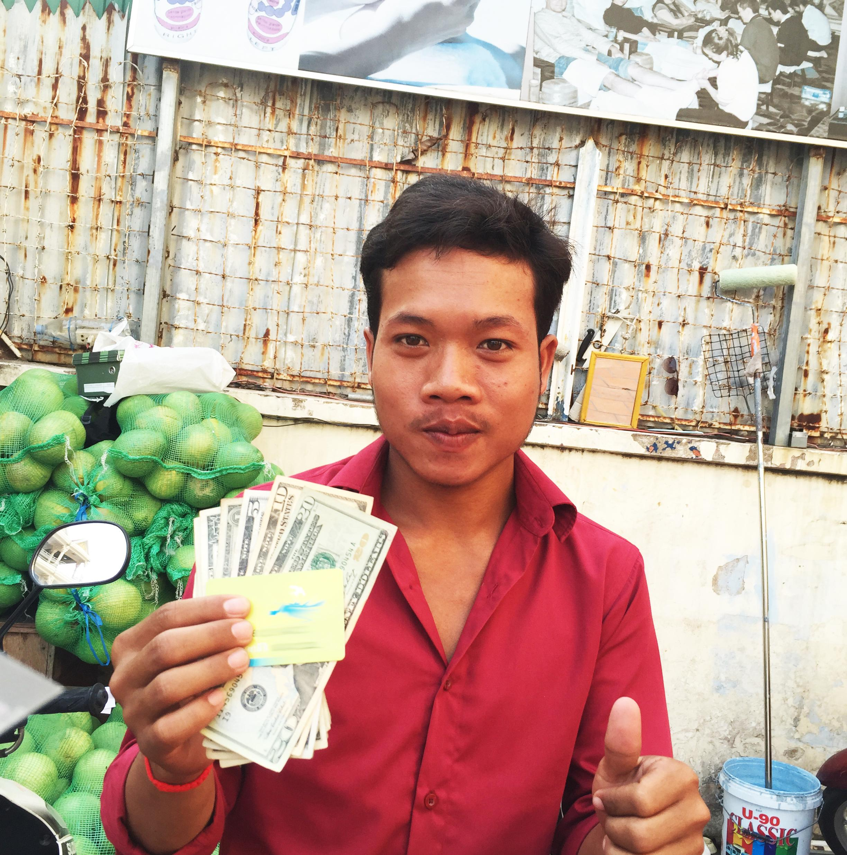
“CONSUMING” begins:
Middle class is growing, GDP is increasing by 6% every year.
Cheap lead generation: all Internet users LIVE in Facebook
Easy money delivering: any SIM card holder has e-purse
20% of citizens have credit histories
Absence of competition: every market participant finds a thought about lending money NON-COLLATERAL scary
Easy regulation: the government doesn’t have enough resources to control different industries

Slide 16
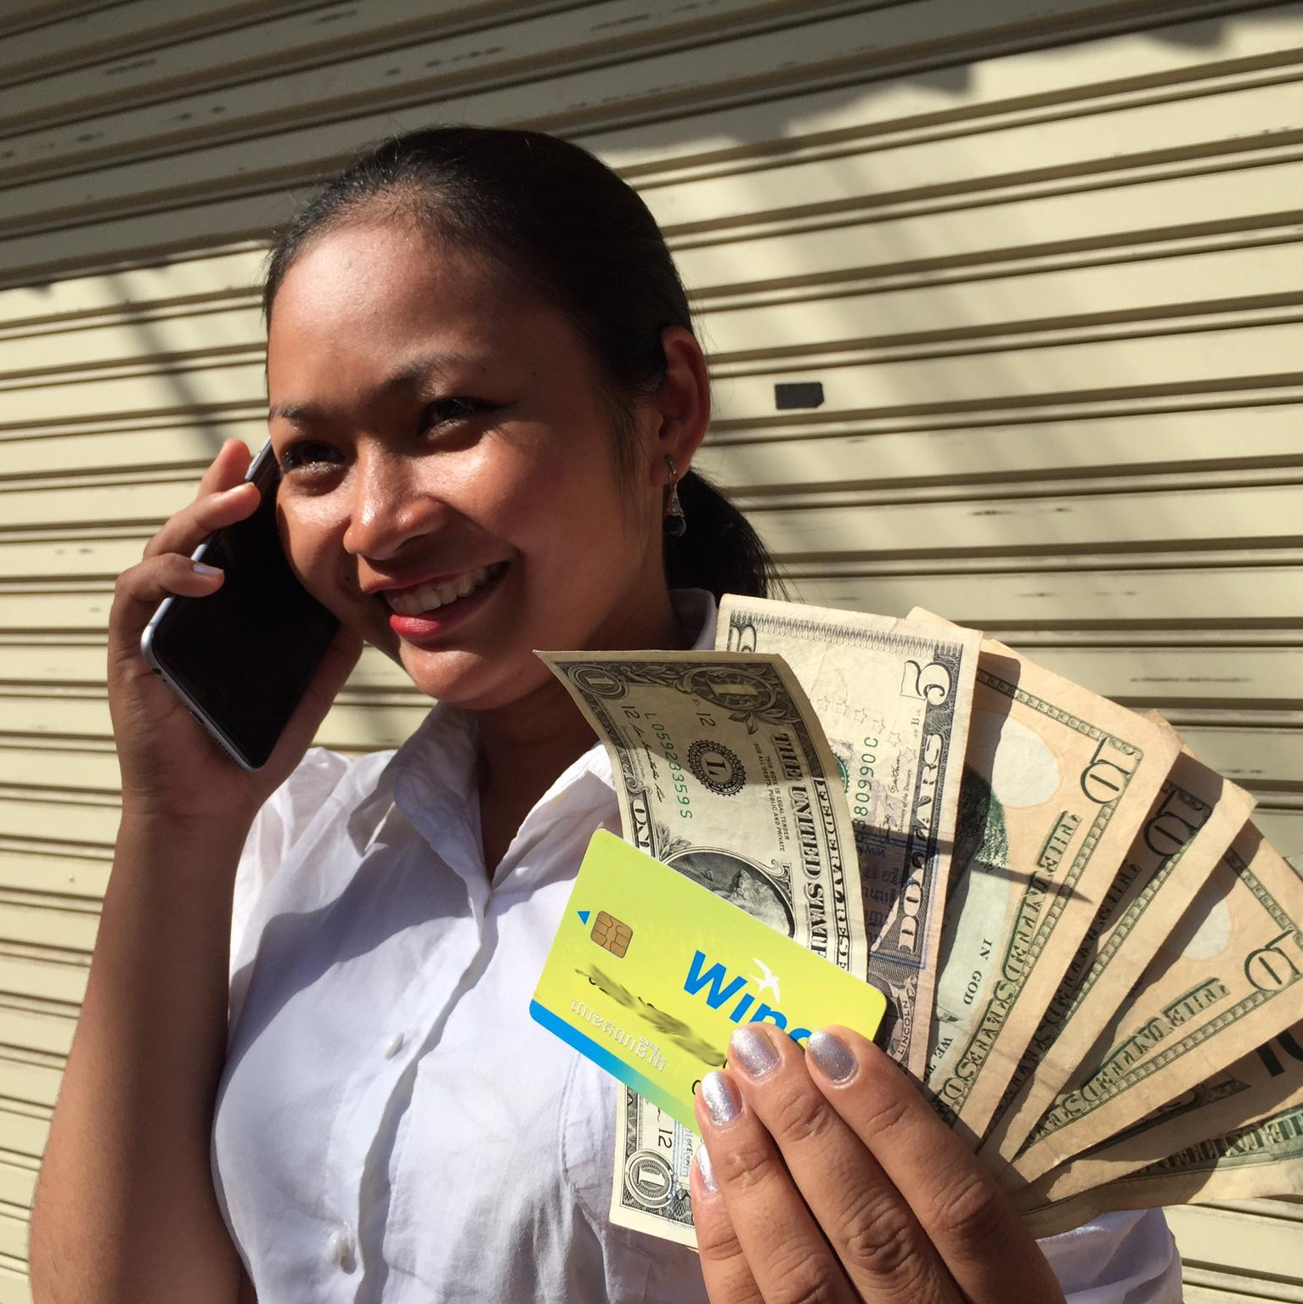
how to sleep well or searching for a local partner
03

Slide 17

Knocking at doors of 30 companies, we’ve found
2 partners
OKNHA SORN SOKNA

Slide 18
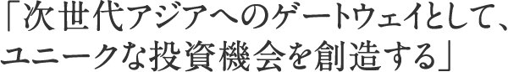
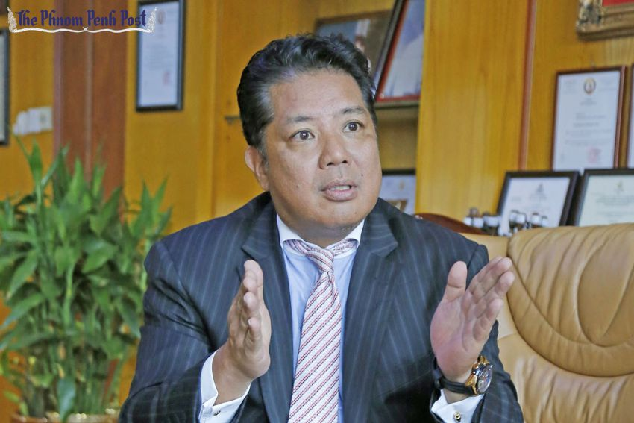

​
Japan venture found -
East Wing ASA Capital
($100 milliion under the regulation)
gave us credence and became a co-founder with 50% participation, and their local partner - Khmer Oknha Sorn Sokna provided us with shelter, office space and full legal support
Tetsuji Nagata

Slide 19
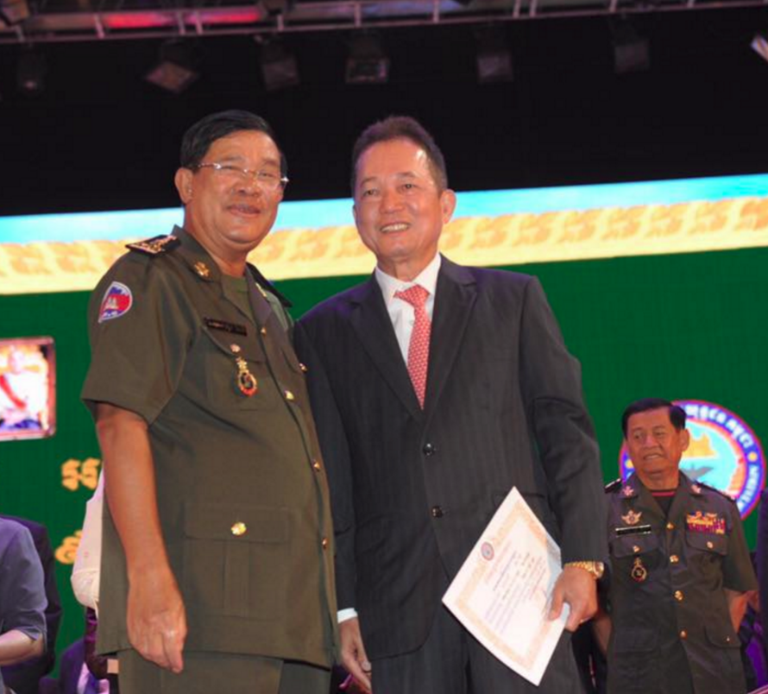
Our second partner
OKNHA SORN SOKNA
Has a TITLE "OKNHA" - the highest social rank among Cambodian citizens (analogue – the SIR in England)
Adviser to the Prime Minister of Cambodia on economic issues
In Cambodia, the Prime Minister is the head of the state (in Russia, Mr. Kudrin has a similar position (the adviser to our President, V.V. Putin)
member of ASEAN
In recognition of his contribution to the development of Cambodia, Oknha (e) Sorn Sokna (e) was awarded a number of royal decorations and awards.
Prime Minister of Cambodia,
The head of the state - Hun Sen
Oknha Sorn Sokna
Our second partner

Slide 20
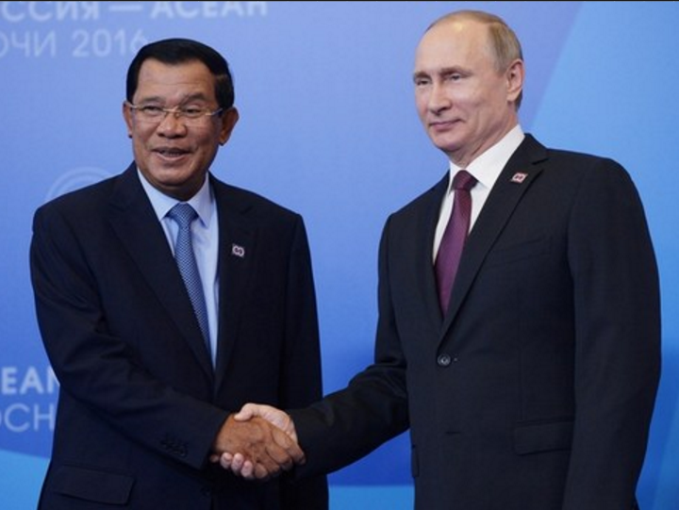
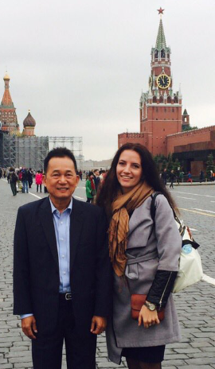
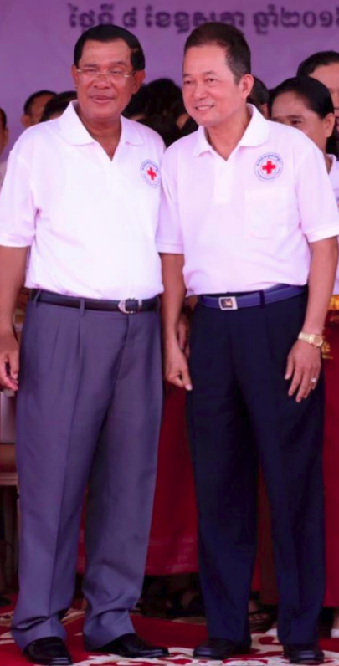
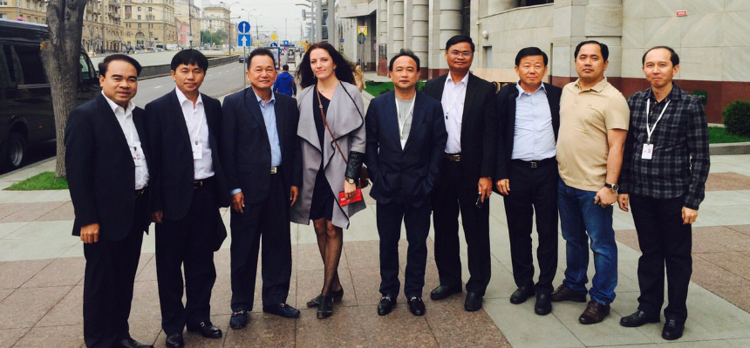
At the ASEAN forum 2016. We are on the delegation
Rule of handshake: in a one handshake we greeted the Russian President

Slide 21
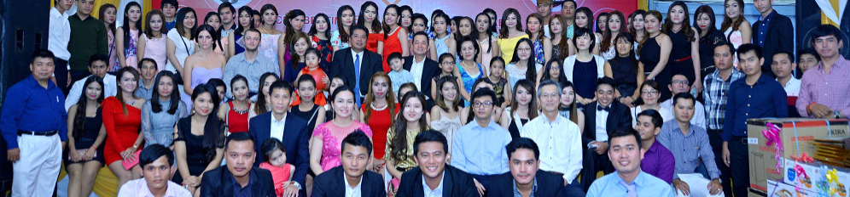
We’ve become a part of the family of our co-founders
We are slightly to the left of the center
And even became known throughout the country
The main newspaper of the city Phnom Penh Post mentioned us in its article
(we got acquainted with the head of the Central Bank of Cambodia thanks to Phnom Penh Post )

Slide 22
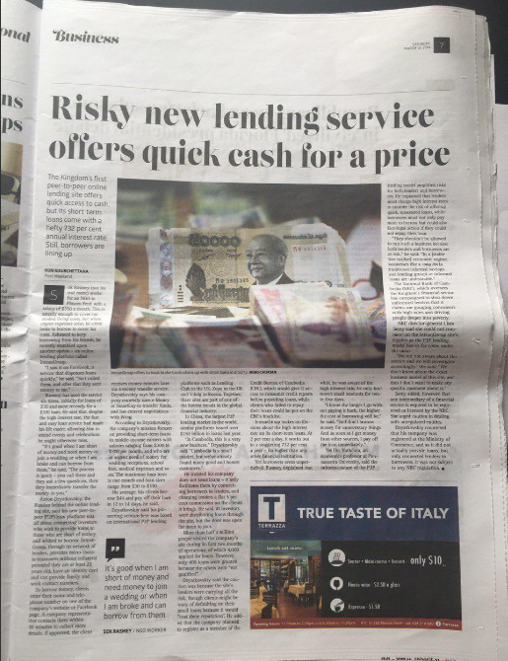

Slide 23
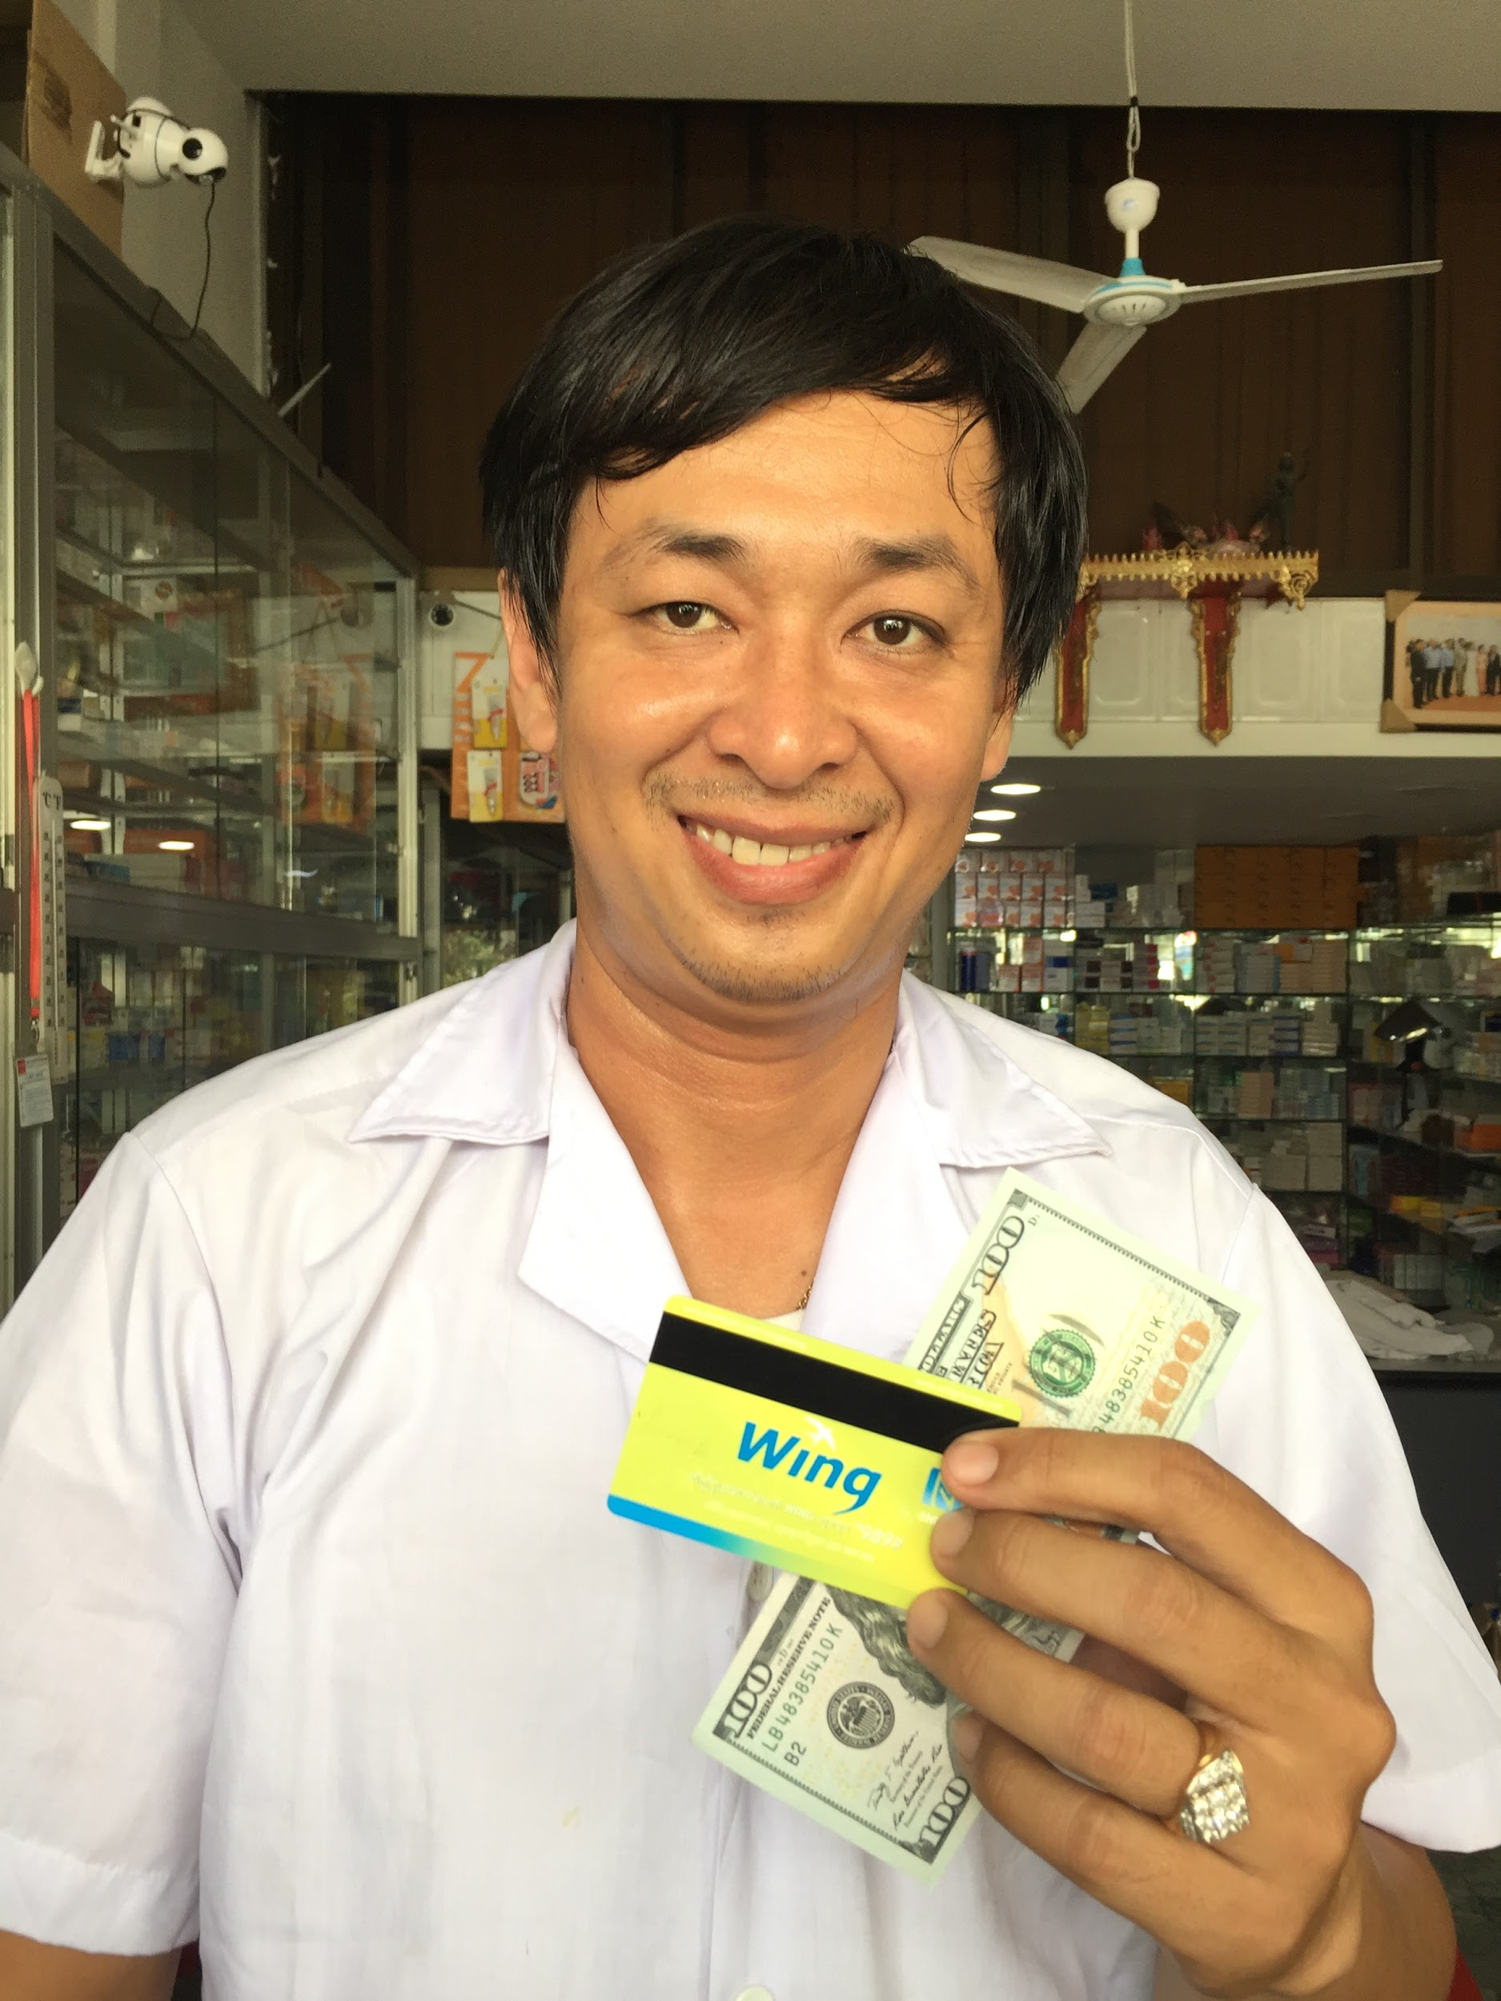
We start to provide loans STRICTLY before the salary 2% per a day
04

Slide 24
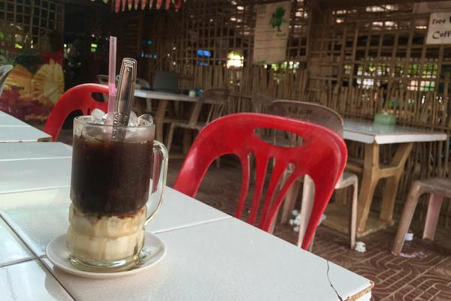
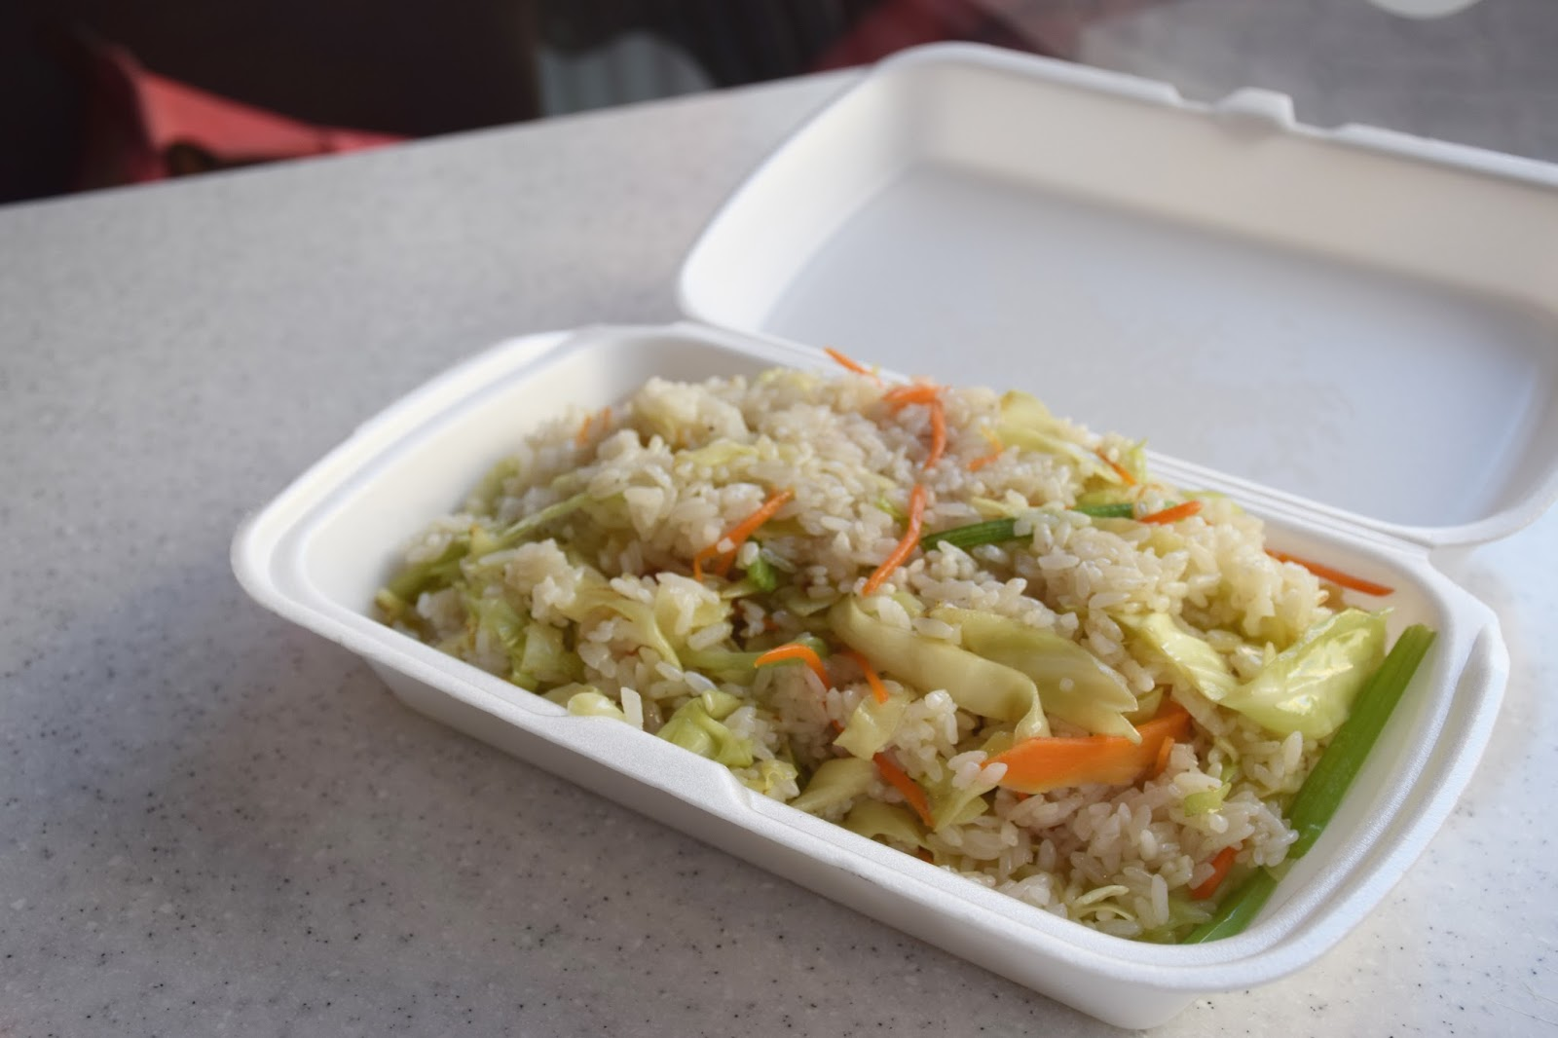
we never say to our customers "2% per day". we answer the question about the cost of the loan in the following way:
“Your loan cost equals the price of a cup of coffee a day”,
Most of clients are satisfied with such answer.
2% from the average loan at $60 –
A bit more than 1 dollar, overpayment is just $14,4
2% = 1 $ = кружка кофе в день
2% = 1 $ в день = тарелка риса

Slide 25
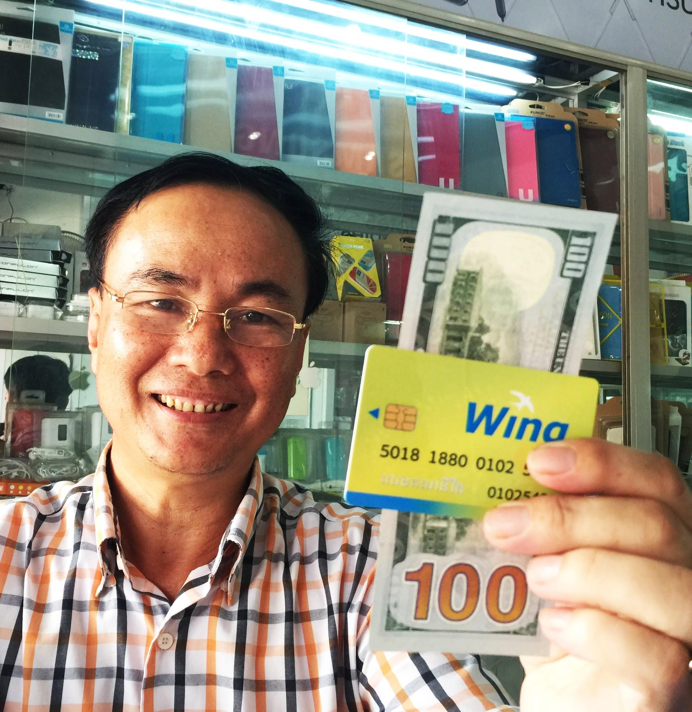
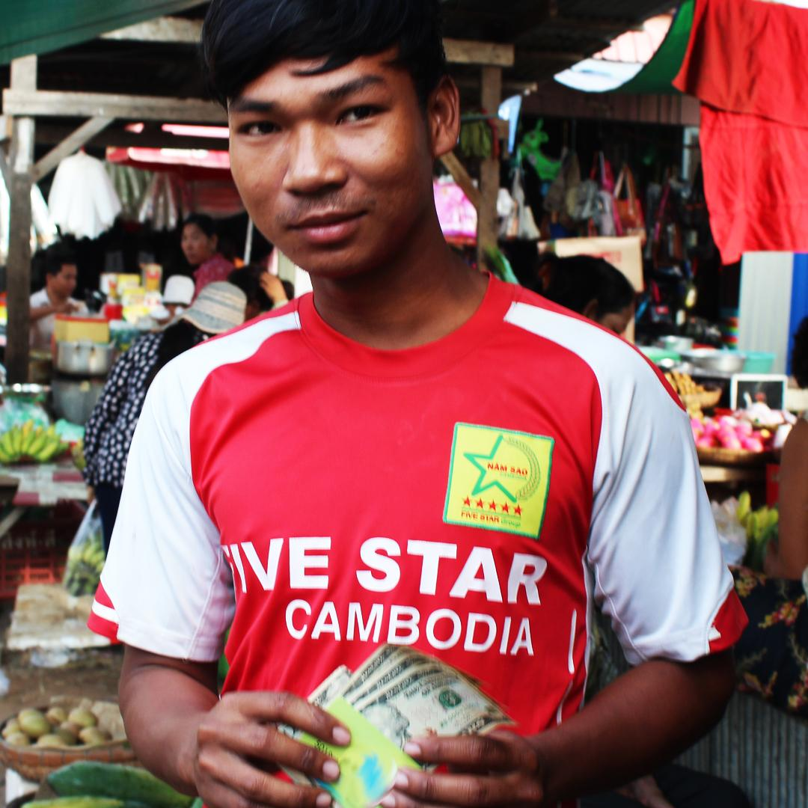
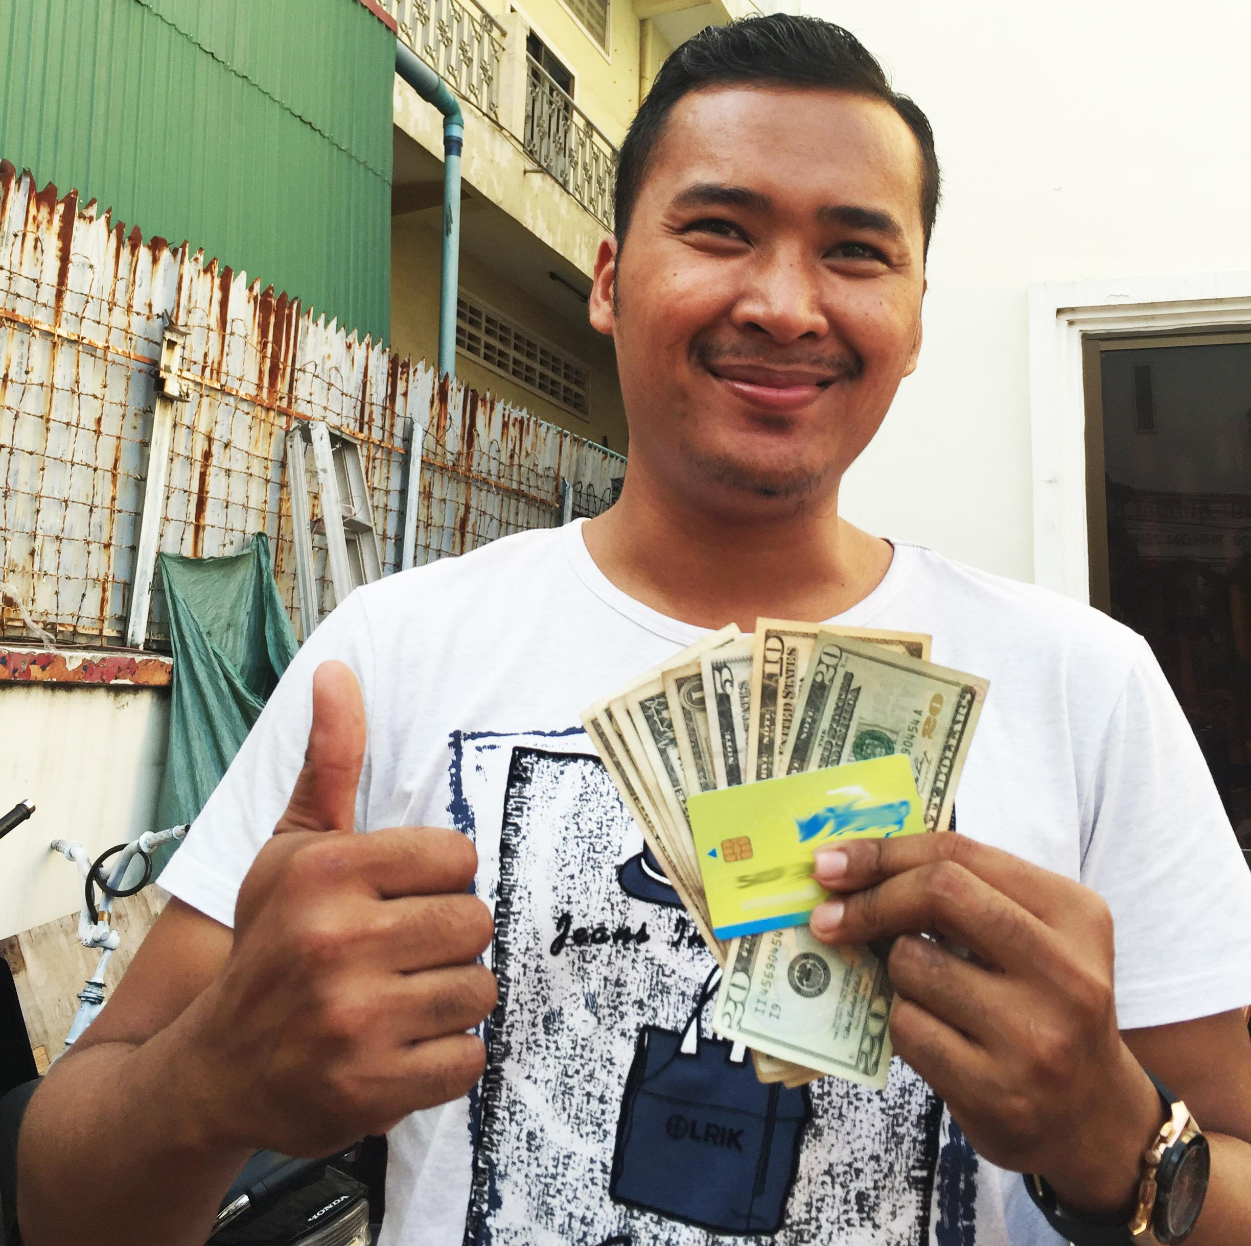


88% - females
90% creditors take the 1st credit in their life
75% - income ~$200

Slide 26
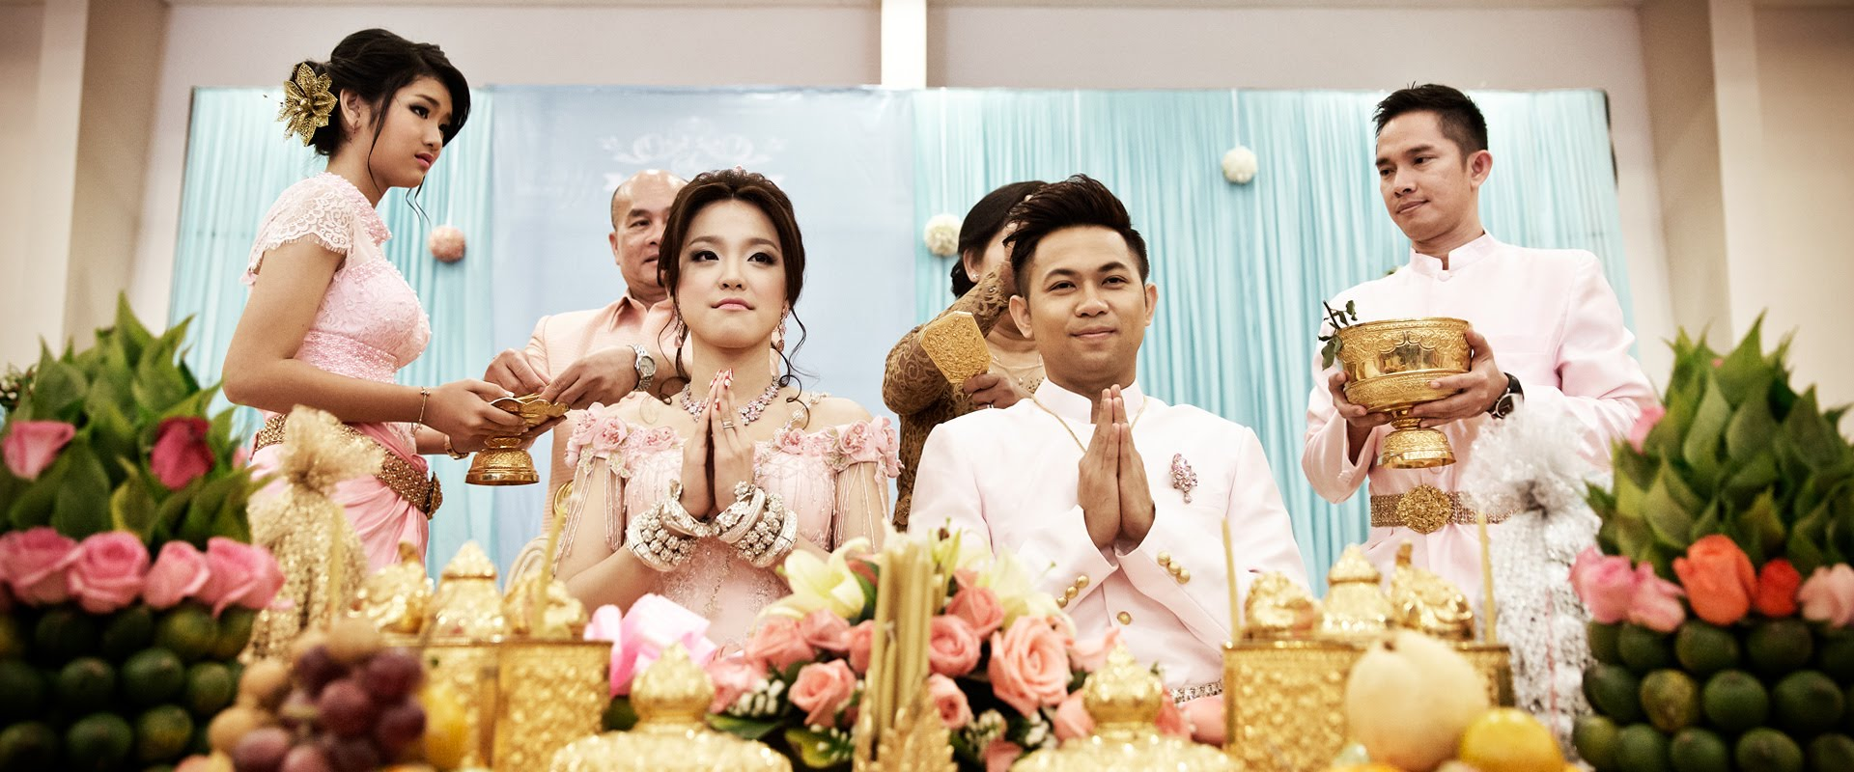
Aims of loans:
- Food - 15% - Wedding invitation - 35%

Slide 27
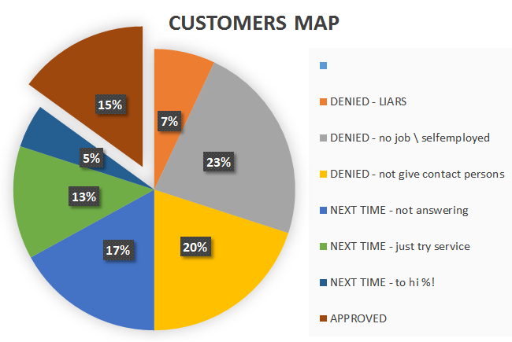
only 5%
of people
find it
EXPENSIVE!

Slide 28
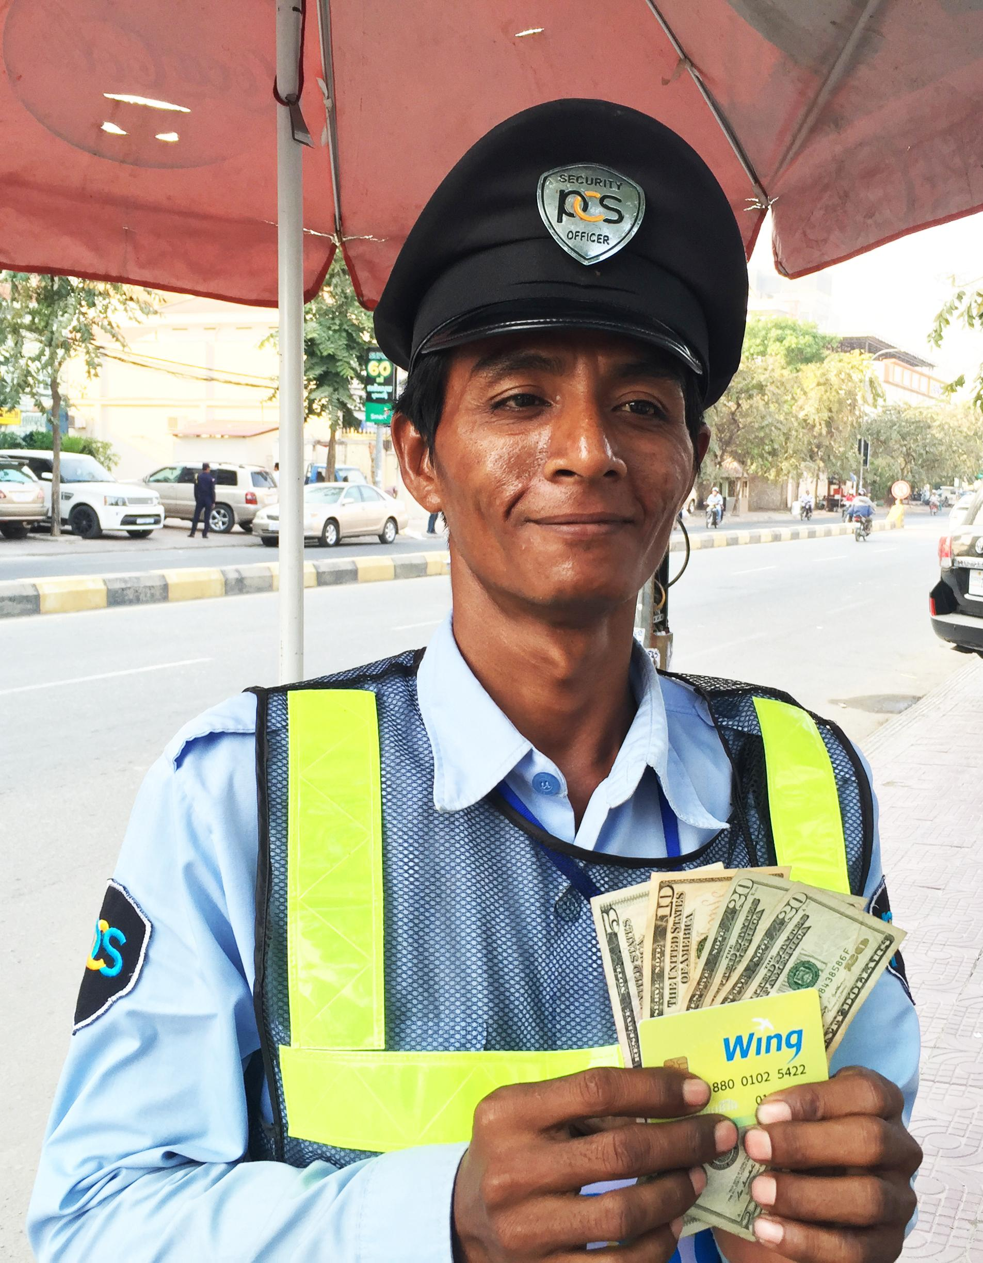
HOW DID WE PROVIDE CREDITS?
05

Slide 29
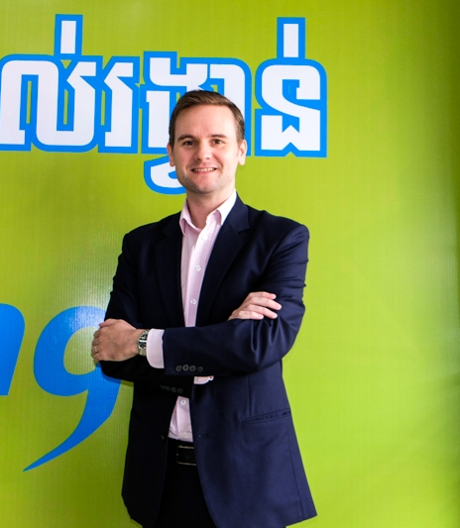
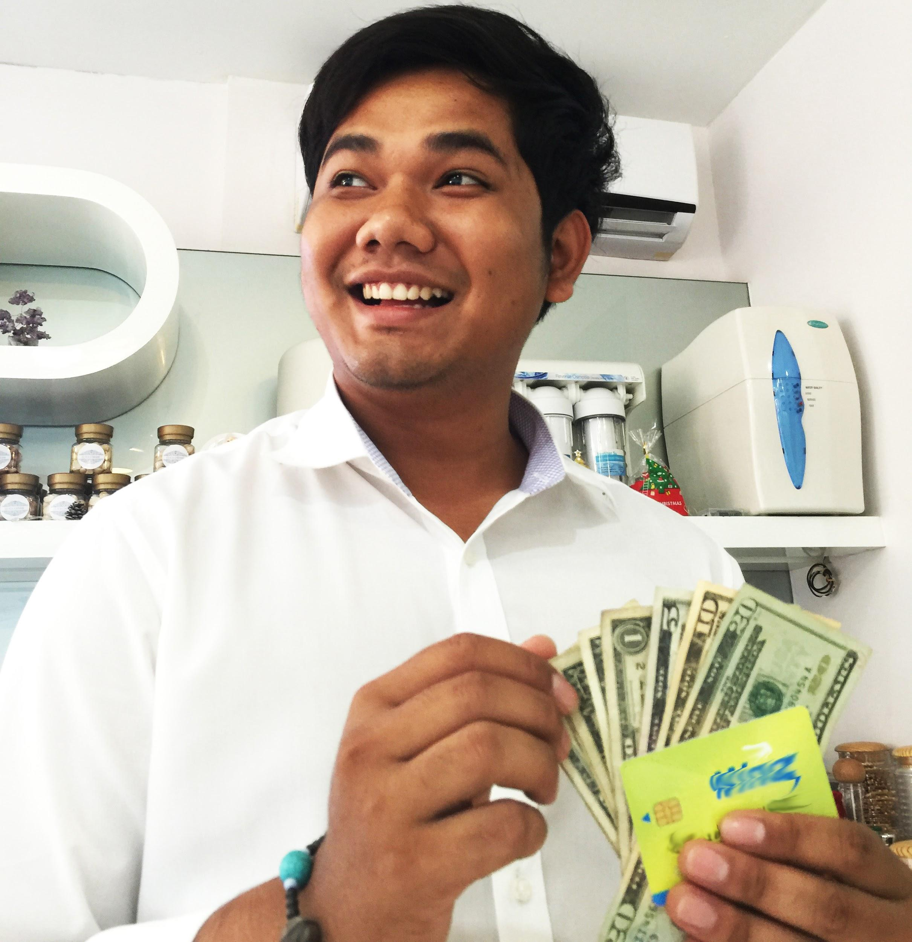

This is the founder of the first payment system -
Antony Perkins, he is also fond of Cambodia very much
We deliver money only to the main local plastic cards which can be got only providing original passports, thus it solves the problem with customer identification.

Slide 30
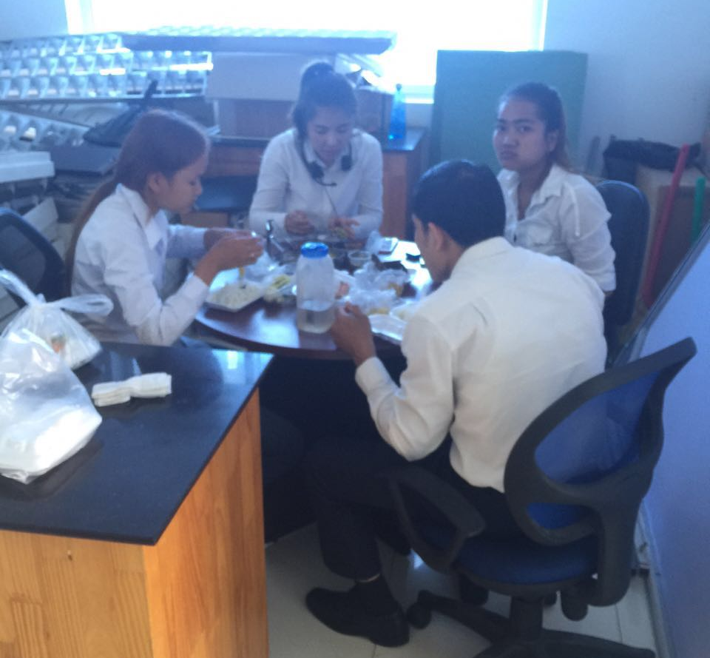
Staff management and its peculiarities
06
The most popular question while getting a job: how long is the lunch time??

Slide 31

To understand HOW to work, you have to know WITH WHOM you work!
Being the owners of the business, we have faced such questions as:
Почему поведение кхмеров поддается определенной закономерности, но не поддается нашей логике?
Why are the most reliable coworkers over 35 years old?
Why is it a challenge to find people of this age?

Slide 32

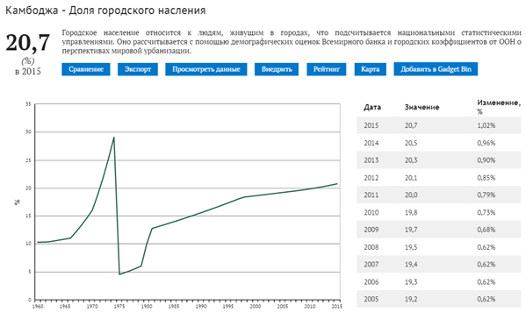
The answers were found in history of Cambodia.
​
The aim of war was to enslave people, eliminate professional class, deurbanize

Slide 33
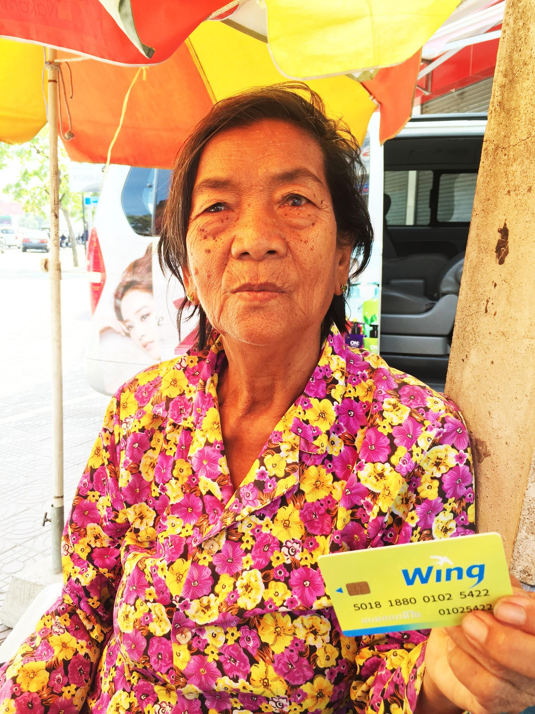
Civil War Witnesses
By the way, also participate in our advertising campaign :)

Slide 34

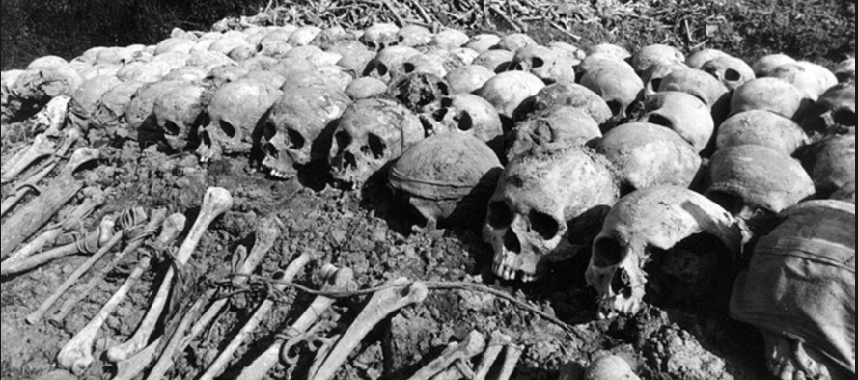
The Civil War 1975-1980
And its IDEOLOGY
«The city is the abode of vice; you can change people, but not cities. Working with sweat of the face to wrestle the jungle and grow rice, a person will finally understand the true meaning of life. It is necessary for him to understand that he originated from the rice seed.
All Cambodians must become peasants»

Slide 35







No matter who you used to be…
You WILL BE a peasant or DIE!
«ECHO» of the Civil War в кадрах or Why is it difficult to find a qualified worker and how does it influence the work process nowadays?
Everyone who wore glasses was shot without investigation. Almost all teachers, doctors, and intellectuals were killed. It was forbidden to write and read
About 6000 schools and all universities were destroyed. All the books in the country were burnt
Paul Pot commanded to get rid of all benefits of modern "white" civilization. Cars were broken with sledgehammers, household appliances were buried in the ground
Money was cancelled. Upon entering Phnom Penh, the "Khmer Rouge" blew up the national bank, and placed a fertilizer warehouse in its storages.
It is difficult to find employees older than 35 (these are people born during the civil war). In contrast to Russia, where employees up to 30 are in favour.
It is a complicated task to find QUALIFIED workers, “thinkers" who are interested in work. And the descendants of the nation are the children of peasants. Our employees are also children of peasants!!
Education in the Kingdom is optional. A share of illiteracy is 30%

Slide 36



And some more national behavior characteristics of employees
The average "lifetime" of an employee in a company is 1-2 months
(especially at the age up to 30!) Khmer does not stick to the workplace, and even his salary does not hold. Khmer does not think about the future. The main thing for him is to grab some money, and what will happen tomorrow- he will think tomorrow, but it's better not to think at all.
THE WAY OF Khmer’s thinking refers to collective
Sabotages and colludes are often take place at work. They can afford themselves to quit job any time they want, the salary which is left doesn’t matter. Unfortunately, Khmer behavior is similar to a childish one.
- The way of COMMUNICATION with the Khmer must be simple enough and primitive. Khmers are single-tasked. Motivation is simple. The introduction of several KPIs misleads them and they expect a dirty trick. Since our eploees work for foreigner, the level of trust is decresing.

Slide 37
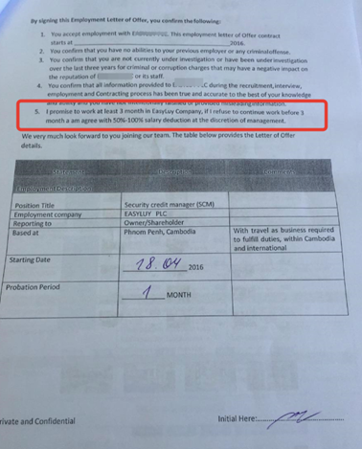
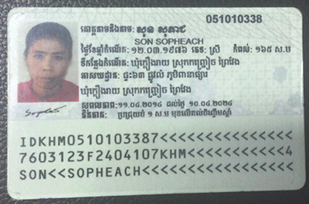
How did we solve this problem?
As far as an employee who worked up to 2 months refers to “money loss”, we:
1
Scored every employee as a borrower
There were cases of commititng thefts by employees.
Stole – got a loan, stole – went in jail
2
Passport (ID) served as collateral
Данный комплекс процедур позволил сформировать постоянный штат сотрудников с апреля 2016г.
3
If you failed to meet contract terms – pay a fine!
3. Контракт, по условиям которого при досрочном окончании работы по инициативе сотрудника – взимается штраф.
4
Salary is paid on the 15th day in a month following the Since often workers got paid at the end of a month, they didn’t show up in the office anymore
Among 400 candidates , only 20 loyal employees work without our total control and participation

Slide 38
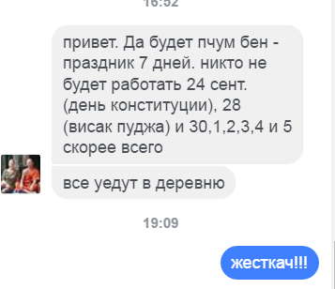

Fraility and futility of workers made us out of despair
Being hiring, applicants had only 2 questions:
Do you have “PUBLIC HOLIDAYS”?
There are 28 days!!! of public holidays in Cambodia in 2016 !
To compare – in Russia there are only 14 public holidays excluding weekends
2. How long is the lunch time?

Slide 39
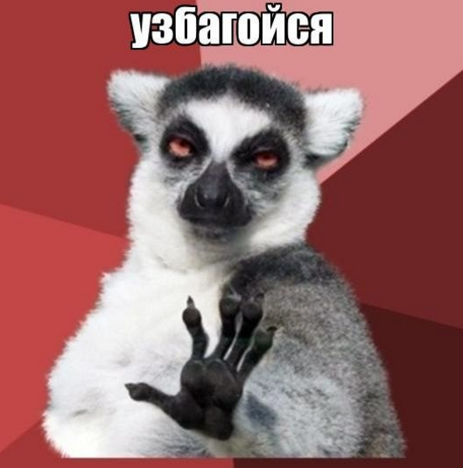
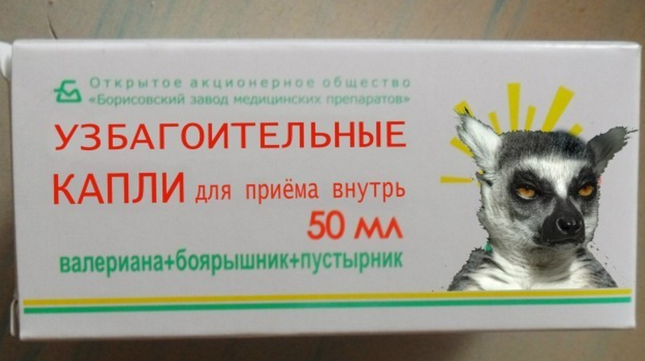
And have a buddhistic peace!!!!
(*together with drops)
And now having become a little more experienced and wiser, we can remember everything with a smile

Slide 40
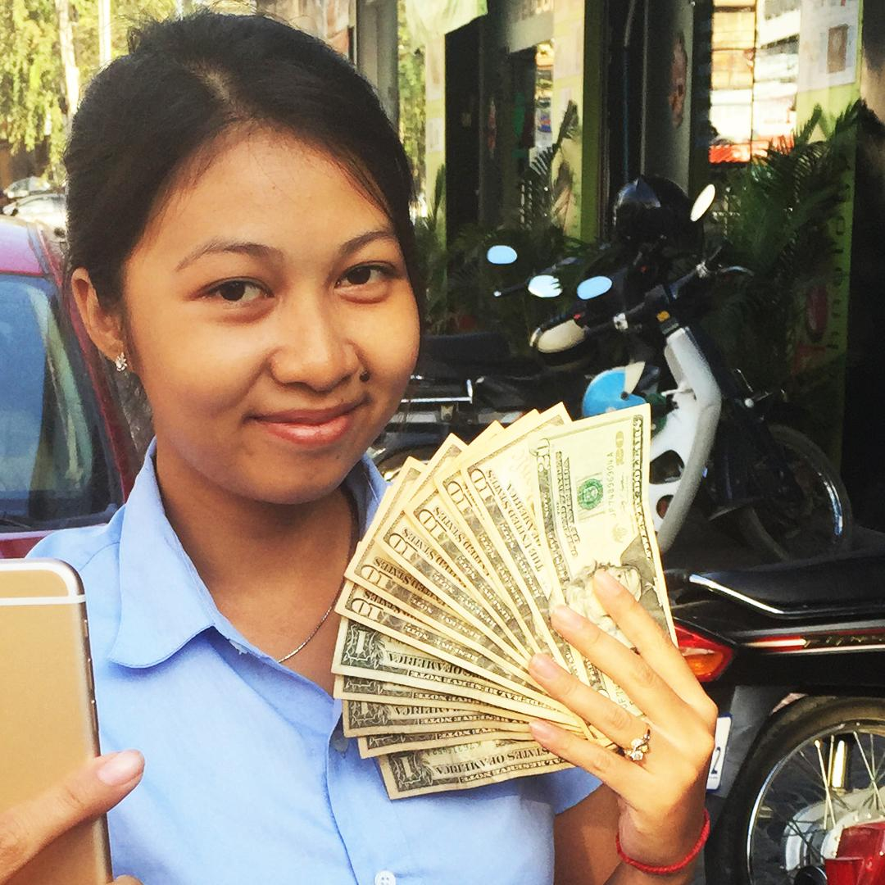
WEBSITE and LEAD GENERATION
07
A lovely girl and hand fanned money:
this trick works in any country :)

Slide 41
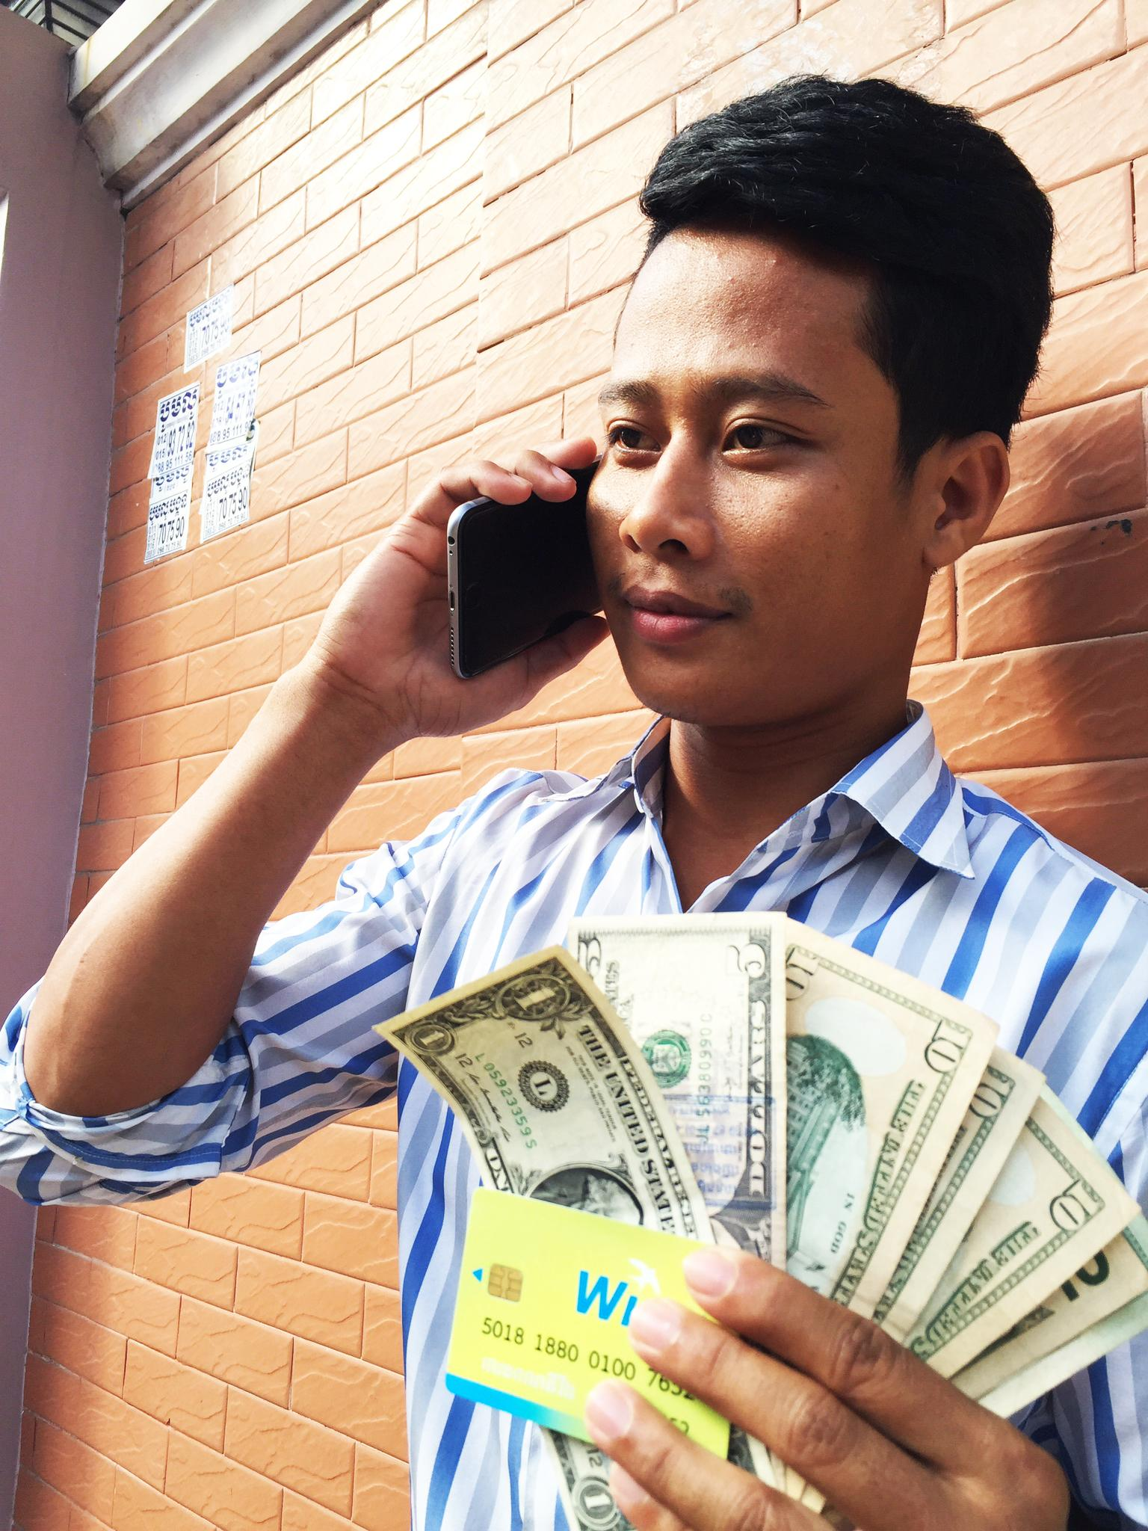
1 completed request costs ~1$.
Approved to every sixth client.
Full cost of overheads for the first given loan:
6$ + OPEX (WAGE + rent)=10$
Average loan - 60$, 12 days.
Loan margin ~ 14,4$.
Cambodia IS:
a lower check - 60$
a lower income - 14,4$ for loan
a lower default - 2% loss 90+

Slide 42
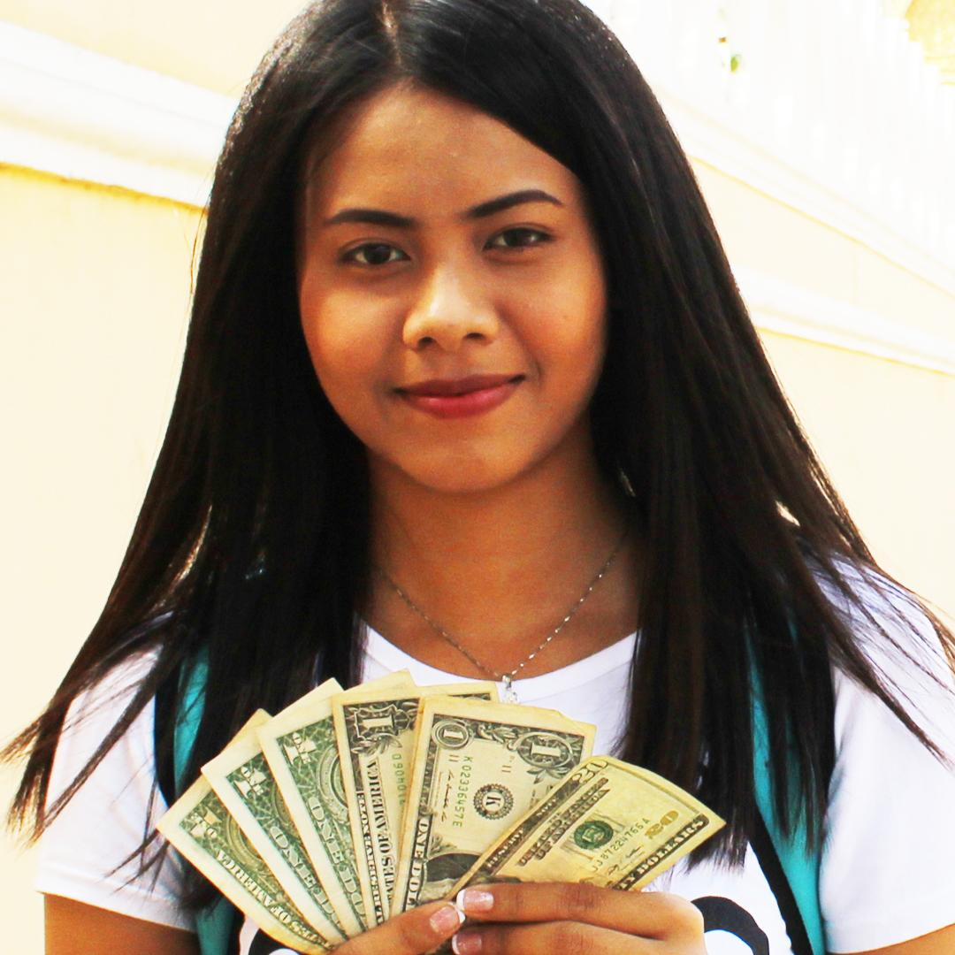
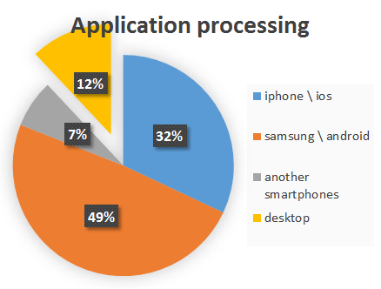
AND NOW EVERYBODY GOES TO A SITE
monusluy.com
88% - SMARTPHONES
A TIP FOR A HOUSEWIFE:
Girls are “clickable” twice time more :)

Slide 43



Our website http://monusluy.com/
This is Anton’s idea and development! And we are proud of our web site very much!
Loan calculator with odd numbers (a small trick for the complexity of calculating an interest rate:)
A little about our advantages in Cambodia:
We are the FIRST, new and UNIQUE service in the country!
Quick money delivering ON-Line!
Non-collateral and no person to vouch
What we can see on the site:
Slogan to get a payday loan

Slide 44


Our loan steps:
the first loan - 30-40$,
with every next loan -+10$
Если 35% цель займа - на свадьбу друзей, то не забудьте взять, когда случится!!! :)

Slide 45


Stories and gratitude of our clients for a FAST financial support in difficult situations
We teach to spend money wisely.
KTV and girls - NO!
For child’s education - YES!

Slide 46




Our website
http://monusluy.com/
Cites of Khmer honorable people about money and loans.
It was quite easy to find cites, but it was MORE complicated to translate them into Khmer

Slide 47

Penetration of Internet. Country’s pecularities
08

Slide 48

For example, I know that my colleague takes my sit at my absence and takes SELFIE! ))
For a typical Khmer
INTERNET = FACEBOOK
*Google is not used
The whole life of a person can be watched through Facebook.
What he thinks, whom he meet with, what he eats!
Where he worked and where he got in.
It is possible to know even the reason of dismissal!
FB – is the strong arm while making decision on:
Hiring
Checking a borrower
Debt collection

Slide 49

FAN Page FACEBOOK
09

Slide 50

We have more than 43 000 👍
Find out our page at FACEBOOK!
inteangroup
An interesting story with a TA:
firstly, we advertised for all audience ratings
then we switched off youths up to 24 (very cheap, but extremely bad leads)
- then we switched off everybody older than 37 (also due to statistics and bitter experience)
- For a dessert: switch off ads among women (women’s lead costed 10 times more (!!!!!!) than men’s one)

Slide 51
Хозяйке на заметку
The audience treat real Khmer photos better than clip arts!

Slide 52


Either food food food posts. (Do you rememner that loans are taken for FOOD?
№1 at attracting the attention!)
You can also influence the borrower through the Fan page: publishing a post with his documents and contact information
Coverage of users for 1 post has increased by more than 10 times for all the period of operating
At average from 300 to 3000 people

Slide 53

MONEY COLLECTION: GOOD BAD ANGRY
10

Slide 54
WE are good cops
During the first month after overdue – we do not act as collectors, but financial advisers, who help to plan people’s budget.

Slide 55
We are bad cops
30-90 days of overdue:
We start to remind insistently, but politely to all contacts about an overdue (more common: SMS, work)

Slide 56
We are very angry cops
90+ days of overdue

Slide 57

MORE COMPLICATED TASK:
THE BORROWER IS NOT AVAILABLE IN NO WAY
CONTACTS ARE NOT AVAILABLE FOR ANY REASON
BORROWER HAS QUITED A JOB.
All the information about the borrower is not relevant.
There is a way out!!!
An example of a successful levy case through FB

Slide 58



1 STEP:
Watching the information in FB
A new added photo with a person in a uniform and with a Staff ID.
Photo from a work place – my confidence 90%
Using FB or Google I can find connection between Petrole Hahn and AZILAY. Information is proved.
Azilay is a new work place of the borrower - 100% of confidence

Slide 59


Step 2: YP & company’s website
Step 3:
Important! While working with borrowers + 90, you should act fast and decisively, even aggressively! Immediately finding a boss.
At Azilay site I can find the Director

Slide 60

4 step:
Our staff prove the information that the borrower really works in AZILAY
Relevant phone numbers of the borrower, his wife and etc.
The borrower had a serious conversation with the AZILAY director

Slide 61

Creativity +
efforts

Slide 62



Our team
levy the death loan finally 5 times exceeding a loan itself.
NB!
in Cambodian cases with overdue over 60 days the only thing that works is attacking the third contacts - these are exactly that people who force borrowers to repay money.
Россия : Камбоджа
1:0

Slide 63

Financial indicators of work
11

Slide 64

Every client took at average 4,5 loans.
Clients got ADDICTED to loans
conversion for the second and the subsequent loans - 73%,
clients want more and more money.

Slide 65
​Conversion to second and subsequent loans
Number of loans per a client | % from the total amount of given loans
≧ 2 and more loans | 72,5%
≧ 5 and more loans | 34,13%
≧ 10 and more loans | 7%

Slide 66

​BAD DEBT
Month | BAD DEBT, %
January | 0,00%
February | 2,62%
March | 5,06%
April | 1,30%
May | 2,68%
June | 4,79%

Slide 67

How we checked clients and how we SHOULDN’T have done
12

Slide 68

We checked clients’:
work, boss,
family
documents
These complicated check decreased the level of approvals!
We understood that there were
no frauds in a virgin market!
Less questions – more approvals!
Our target – to lend at least 10 dollar to everyone

Slide 69





We used lots of cross checks:
work – colour of building, number of floors, contacts, parents – date of the son’s birth, relatives – home address.
RESULT: THOROUGH scoring is needed ONLY for mature overcredited market

Slide 70

CRM or ROBOTS run
13

Slide 71
Having processed 10.000 clients in EXCEL
>>we switched to
BPM by TERRASOFT
with great pleasure

Slide 72
Do you remember our personnel problem?!

Slide 73

Now the worker’s task is:
To read the text on the screen only.
With expression, preferably.
Other things will do CRM
SHORT CRM:
I want to place any monkey in front of PC, that has a bit of reading and speaking skills.

Slide 74


EPILOGUE: Having invested everything we had, and taking risks... For 1 year we lived at work from morning till night ... saving literally every dollar…
$1 per one
Price in Cambodia
this is Rolls Royce. 2 years ago I bought it from a dealer
…and these are bones. They turned out to be an excellent soup! when you have a HARD ECONOMY

Slide 75



глава последняя:
We got profits from the third month...
...but, ate the whole Asia…-

Slide 76

… - SOLD A BUSINESS!
90% of buyers wanted to buy it with us, but we denied politely)))
We have learnt a lot today...
LOCATION !
LOCATION ! ! !
LOCATION ! ! ! ! !
market capacity - is of paramount importance.
Do not start your business in tiny countries

Slide 77

Dear colleagues!
Learn our experience and earn money! Earn on a global scale and in a lot of countries!

Slide 78





Any ideas?
Any questions?
Take photos and call us!)
londa_n
anna_n111@mail.ru
+79529153598
+79646486357

